Slide 1

YGROUP: Test Case Study
Video-games market analysis
Notes:
To change the image on this slide, select the picture and delete it. Then click the Pictures icon in the placeholder to insert your own image.

Slide 2
Index
Objective & available information
Research flowchart
Analysis
Platform
Target market (geographical)
Genre
ESRB Rating
Publisher
Conclusions
Defined Business Strategy
Real-life case scenario

Slide 3
1. Objective and available information

Slide 4
Objective and available information
Main goal
Define business strategy of a videogames developer company to help them maximize sales
Information used in analysis
Dataset containing sales and characteristics of all sorts of videogames in the time range 1970-2019.
55,793 videogames in total
21,204 games used for analytical purposes these had some type of information regarding their historical sales (rest had no information at all)
Most important features analyzed:
Year of publication, genre, ESRB rating, global sales, sales per market, publisher.

Slide 5
2. Research flowchart

Slide 6
2. Research flowchart
Steps followed in the analysis performed to obtain the optimal market strategy
The order in which these games’ characteristics have been studied correspond to the degree of impact they have on the final business strategy
Platform
Target market
Genre
ESRB Rating
Publisher
Full Dataset
Market strategy
However, all steps are equally important to obtain our goal of maximizing sales

Slide 7
3. Analysis
Platform

Slide 8
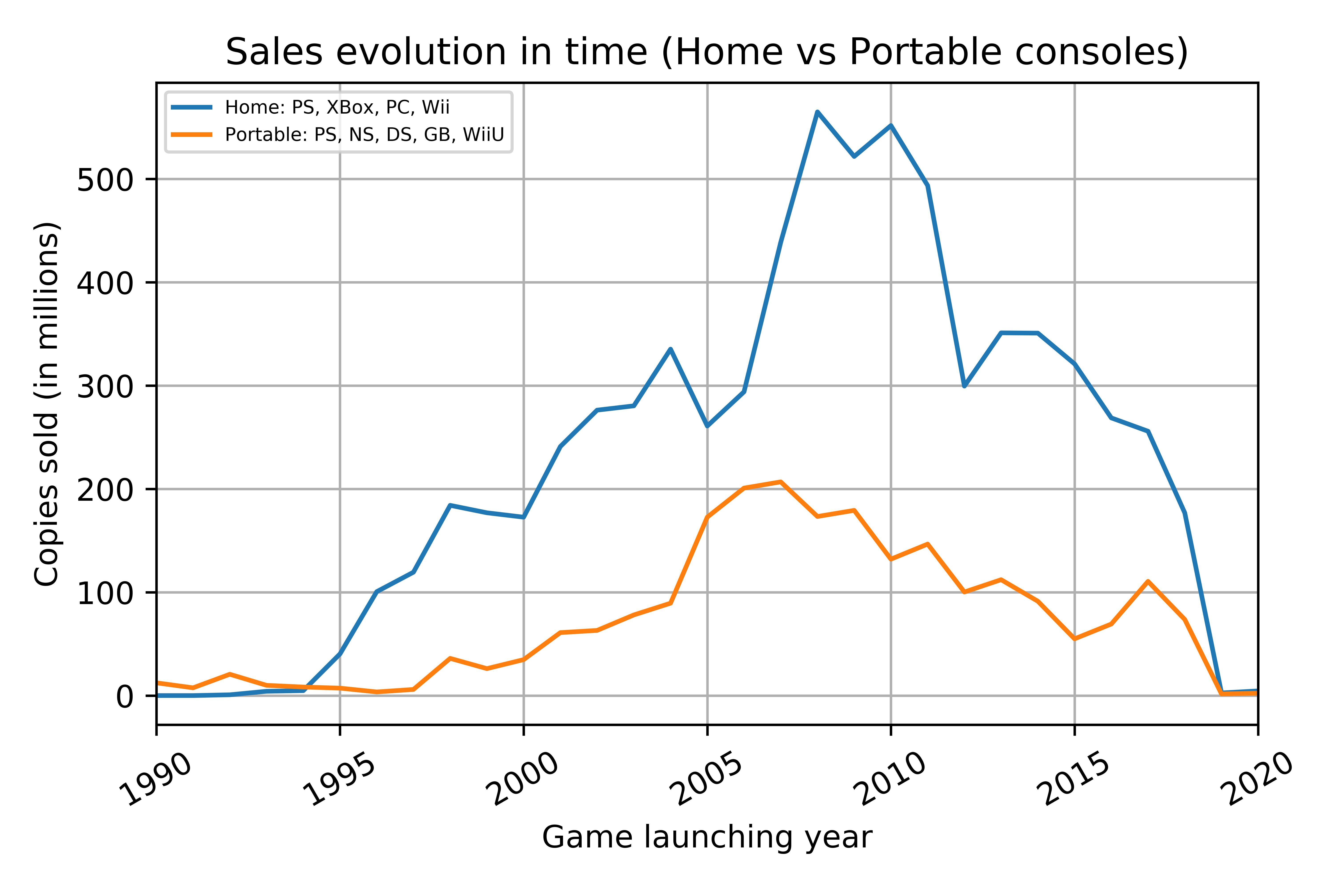
Platform: Home or Portable Console?
Home |  | Portable
PlayStation | PS1 | PlayStation | PSP
 | PS2
 | PS3 |  | PSV
 | PS4
XBox | XBox | Nintendo | DS
 |  |  | 3DS
 | X360
 |  |  | NS
 |  |  | GB
 | XOne
 |  |  | GBA
 |  |  | WiiU
Nintendo | Wii
PC
Home consoles are more powerful than portable ones at the moment
Seems that traditional way of gaming (at home in front of TV) is still dominant

Slide 9
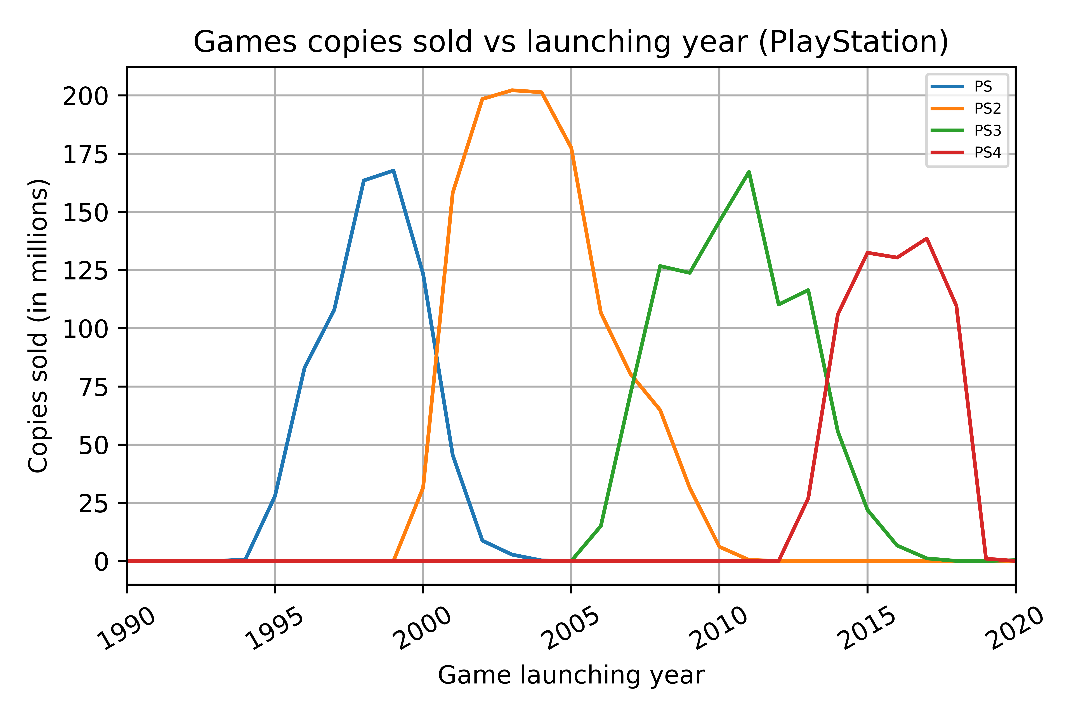
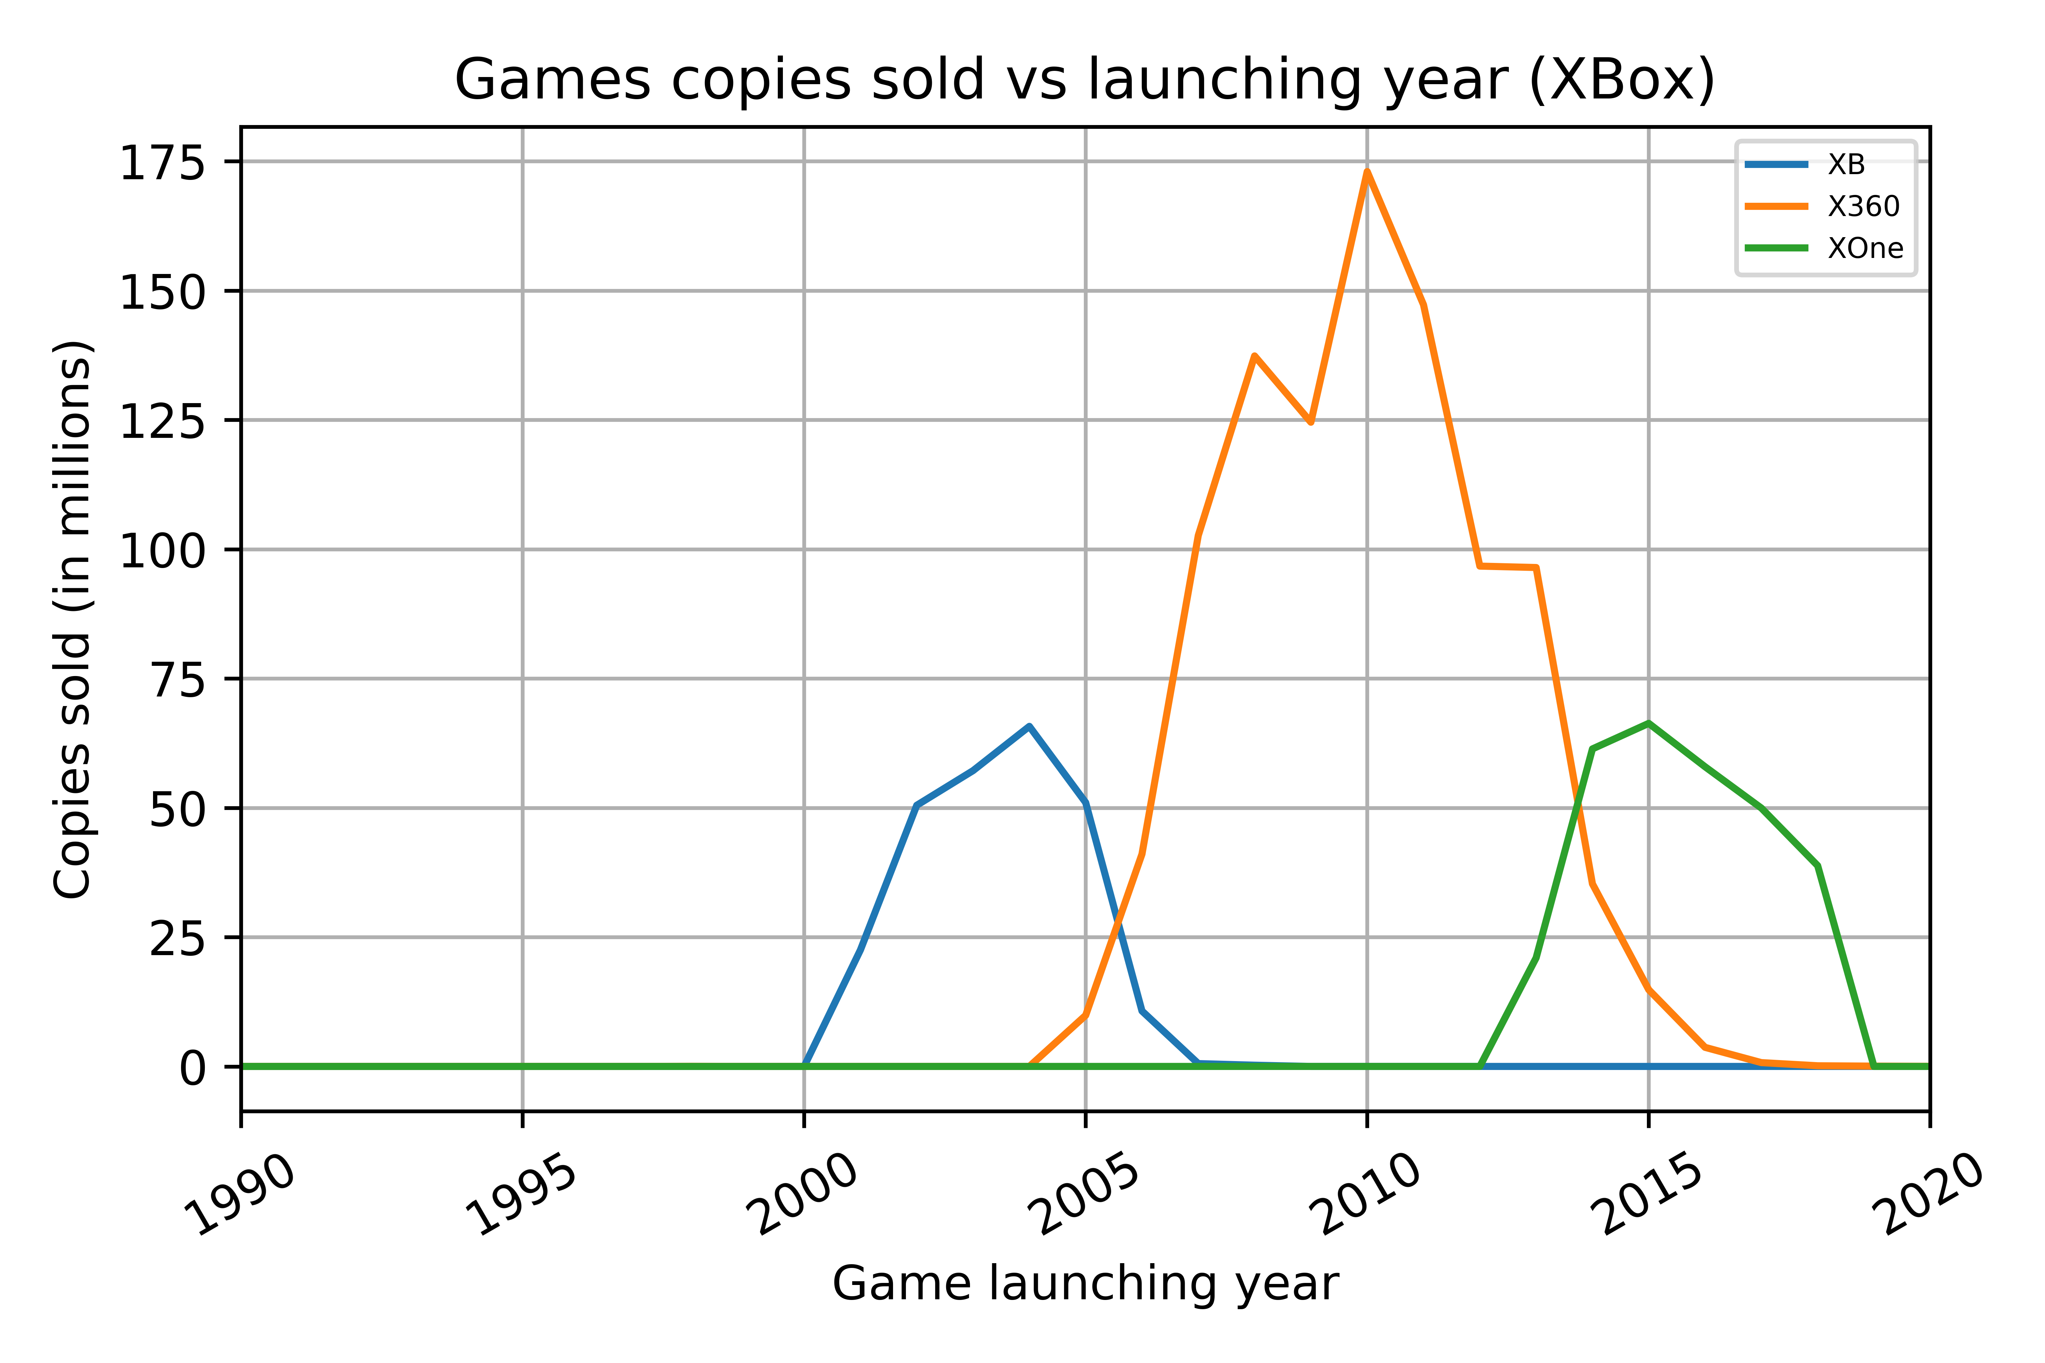
Platform: Home Consoles Study (1)
PlayStation platform has been dominant in the market by means of 4 main consoles (PS, PS2, PS3, PS4)
XBox platform has been PS competition from the PS 2nd generation console (PS2 / XB)
Both platforms stay competitive in the market by means of upgrading their console every 5-10 years

Slide 10
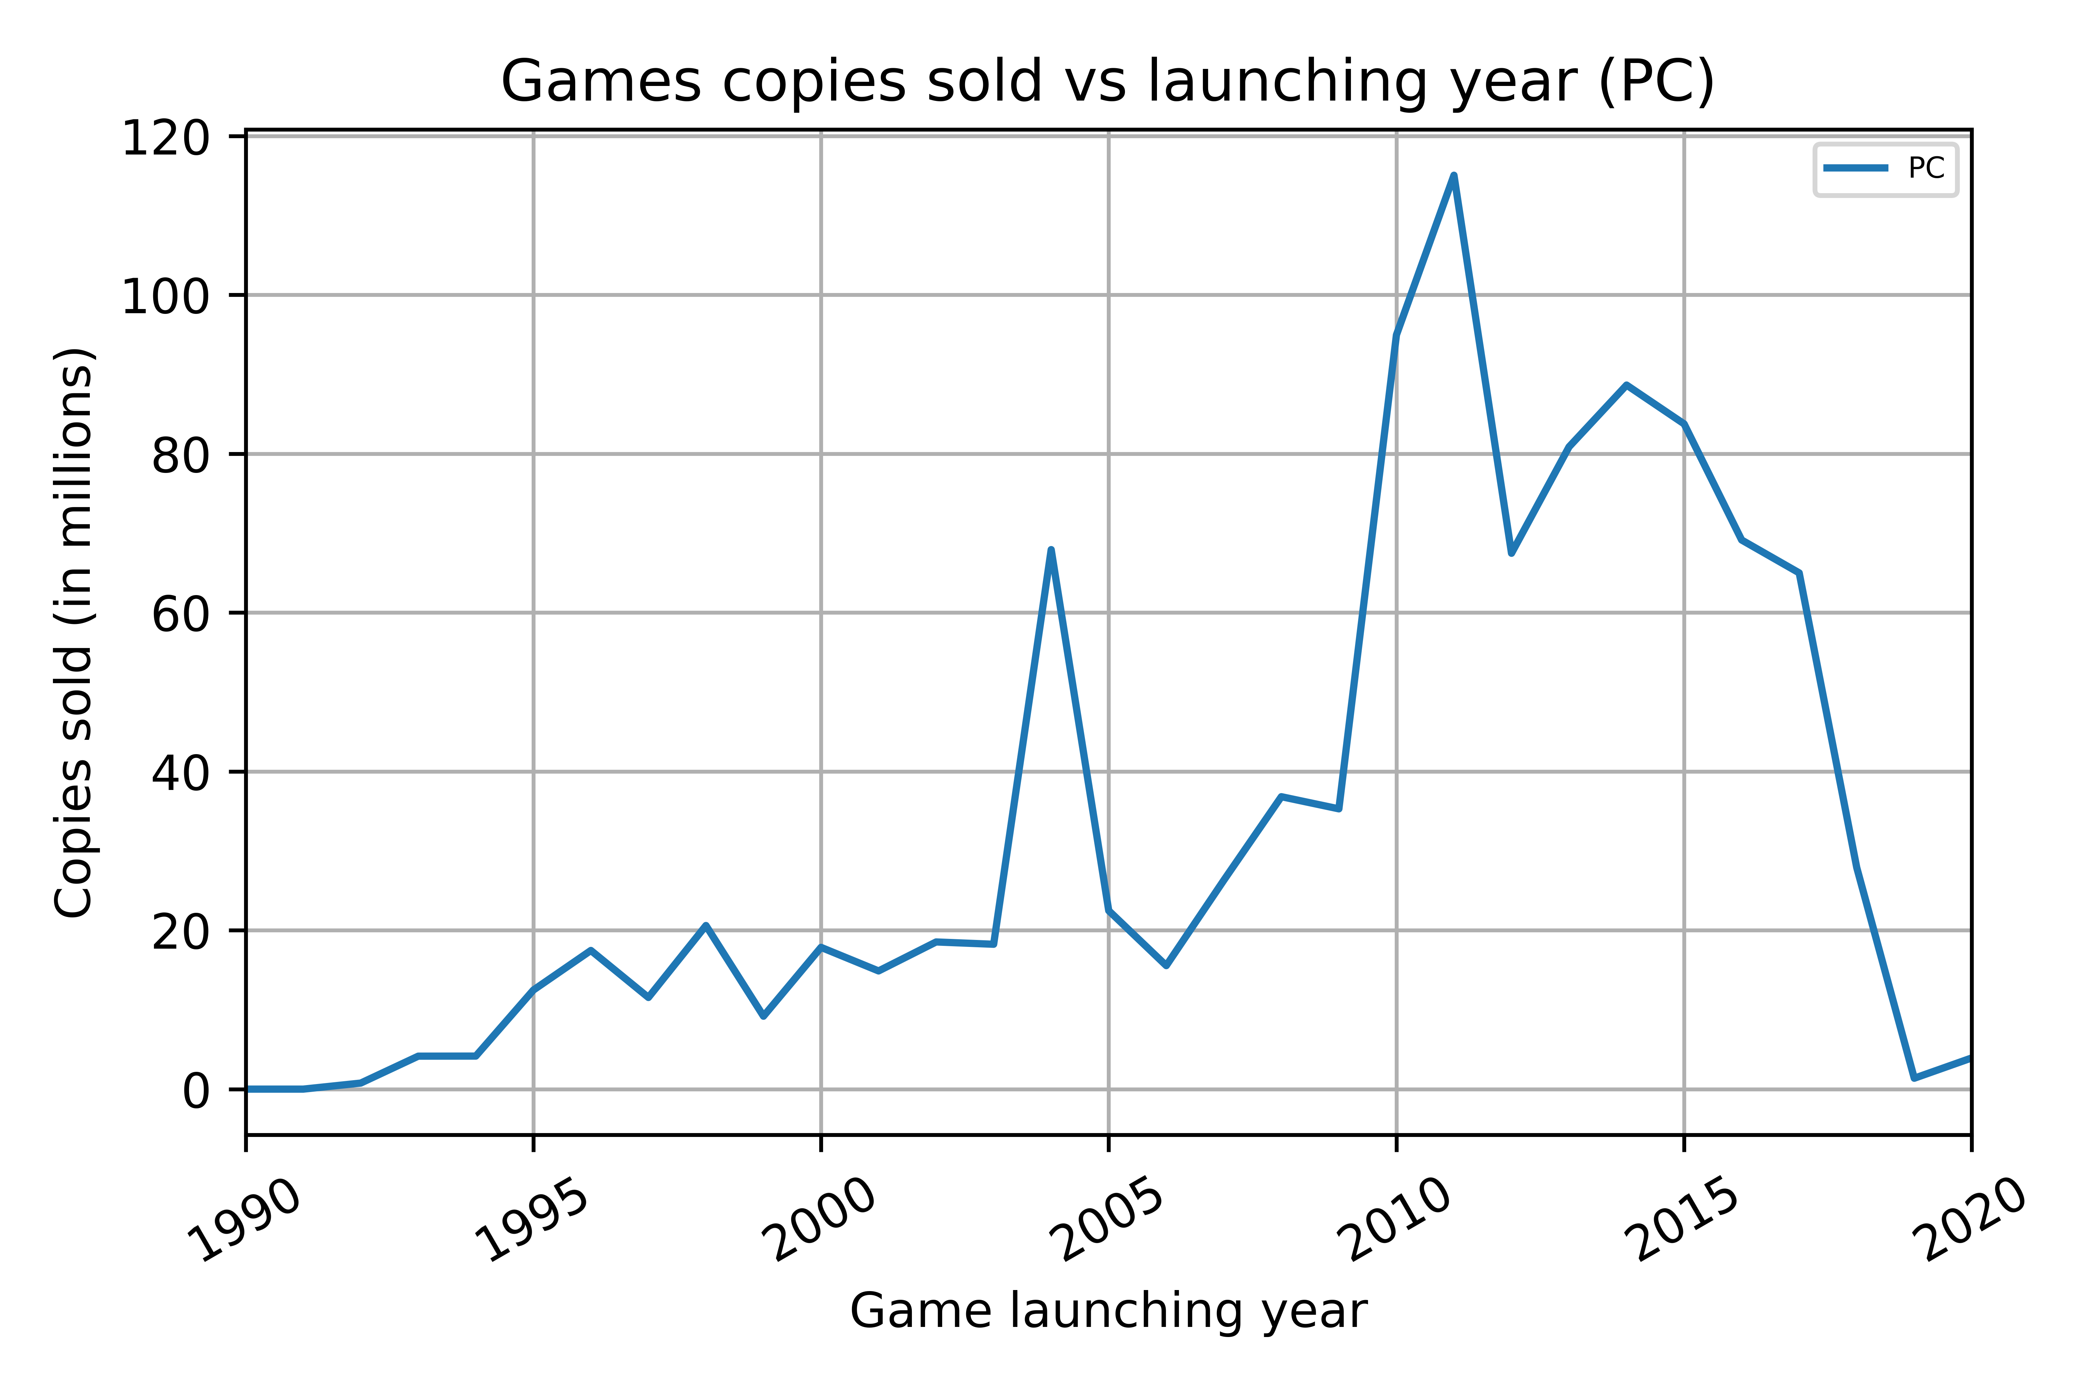
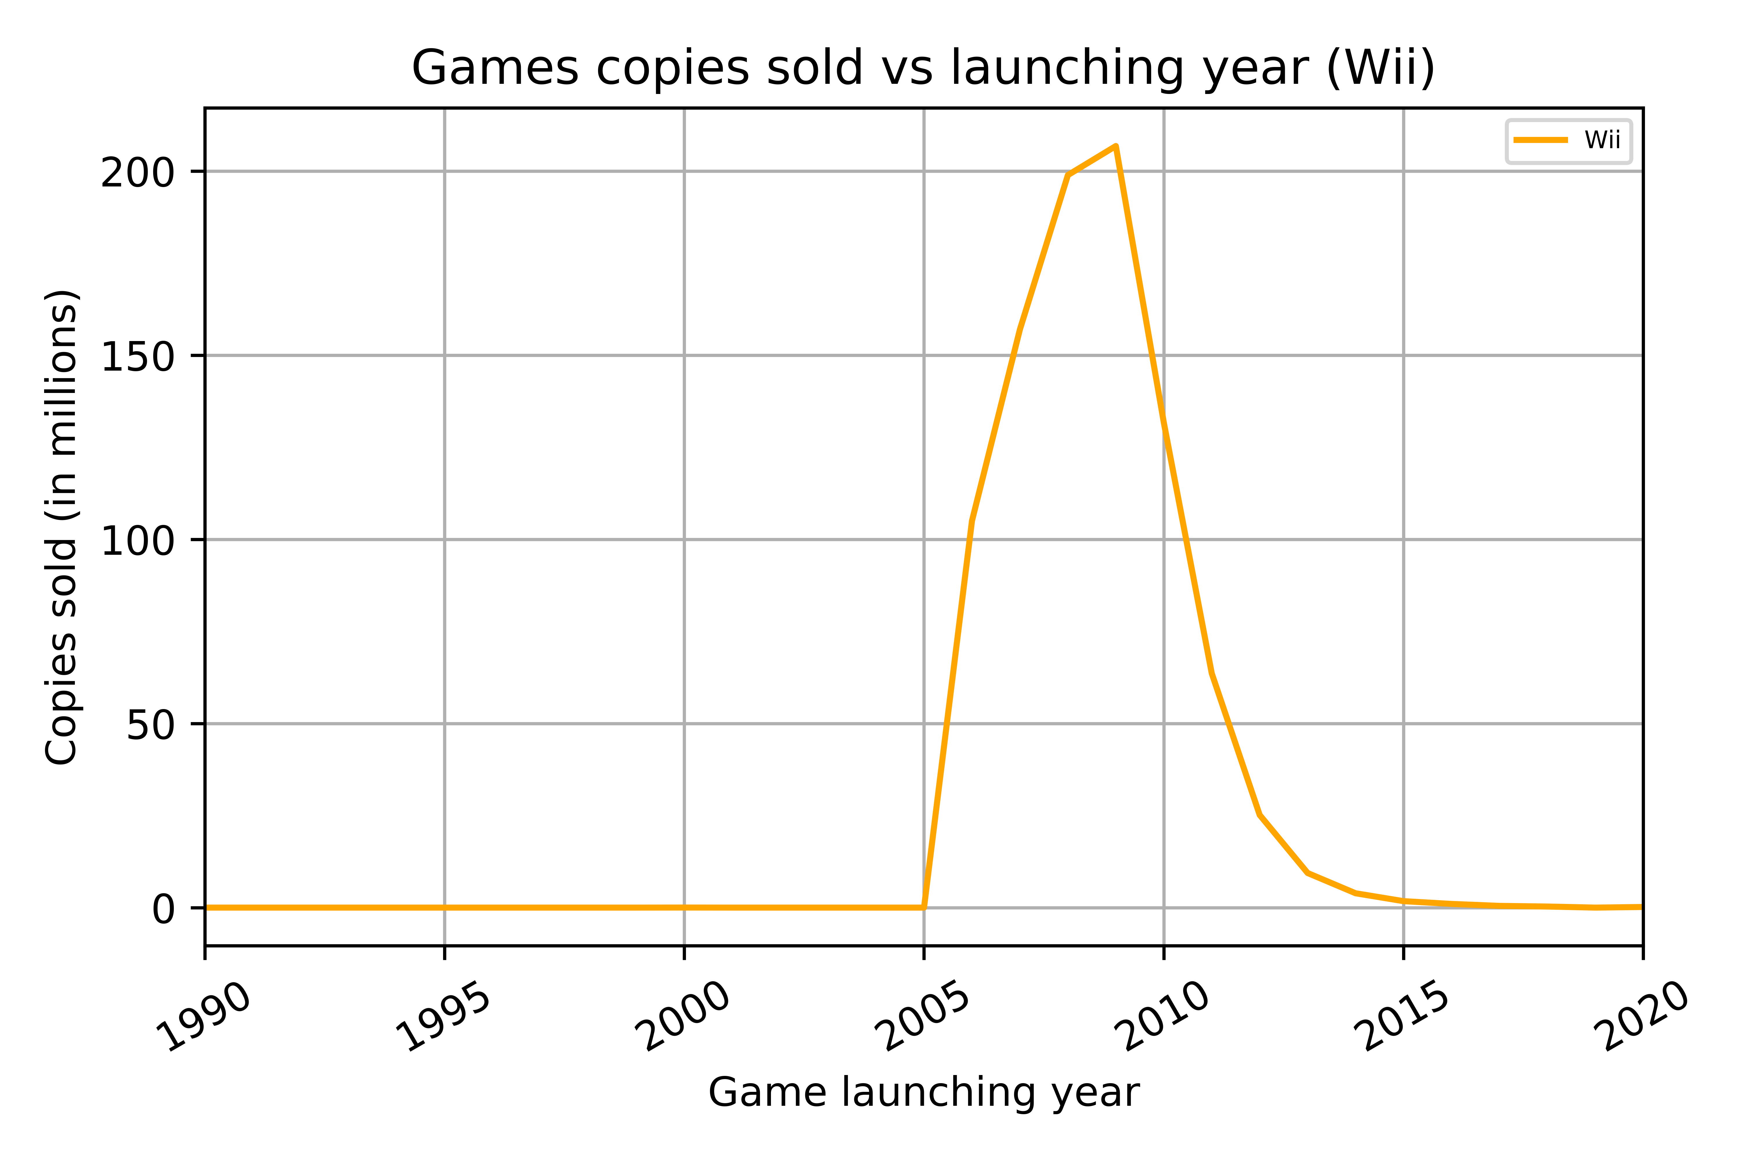
Platform: Home Consoles Study (2)
PC has been growing in the market from the start
Wii was a huge success at launch because of new way of gaming (moving around & exercising) but went out of the market completely around 2010

Slide 11
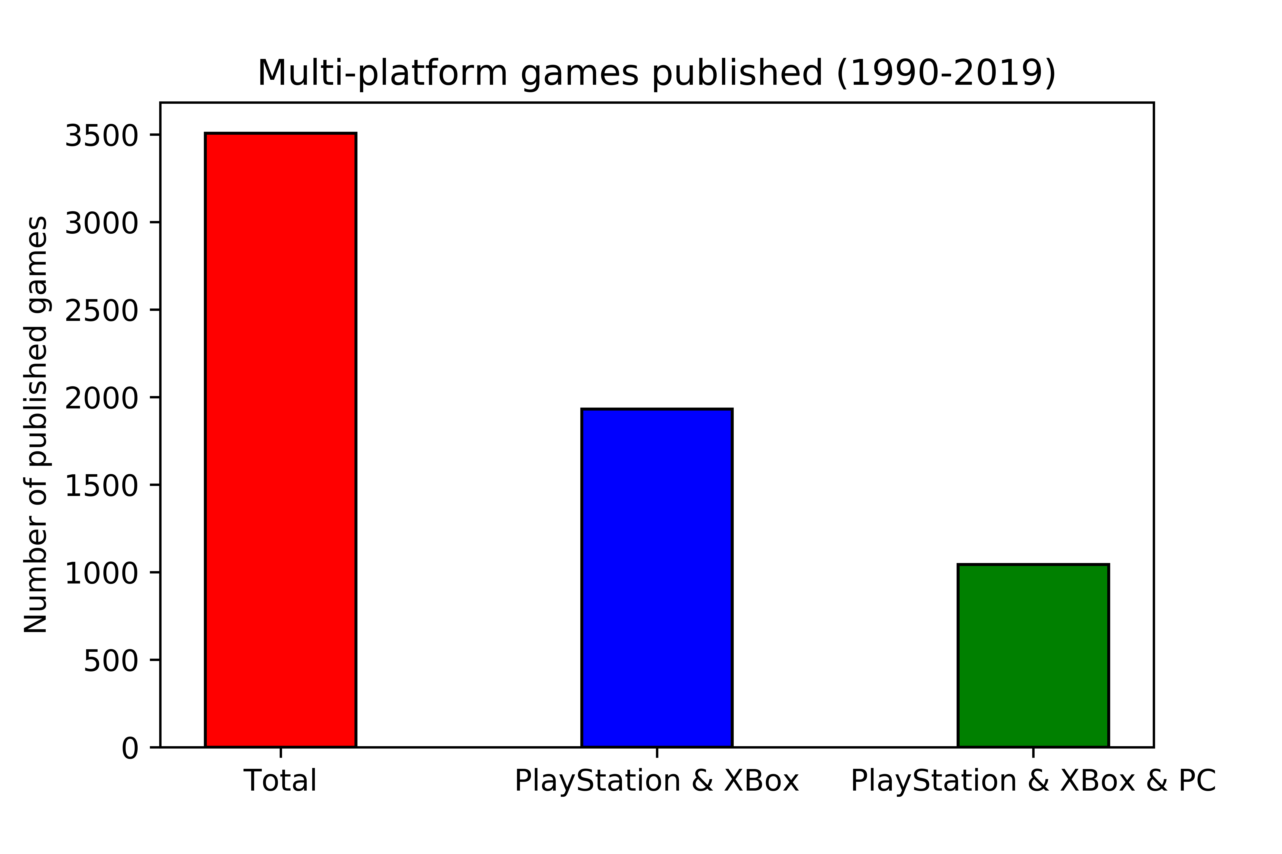
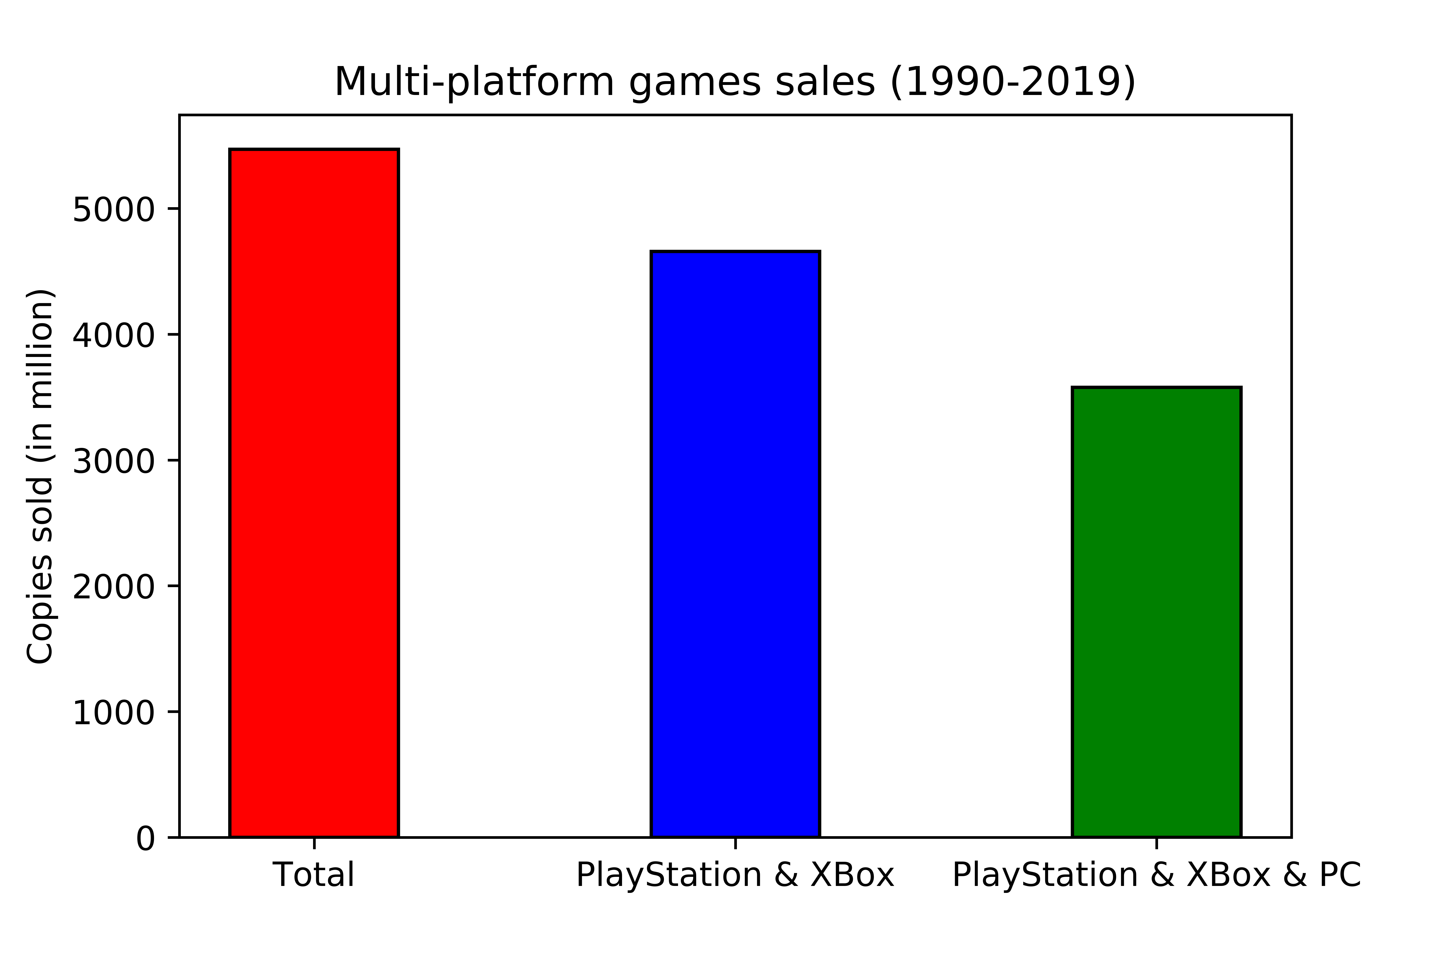
Platform: Multi-platform analysis
Out of 21,204 games studied: 9,947 are considered as multi-platform
They can actually be grouped in 3,507 games
More than 50% of multi-platform games are available in PS and XBox platforms; 30% if including PC
85% of multi-platform game sales come from games available in PS and XBox; 65% if including PC
Most influential and successful games in terms of sales tend to be available in various platforms
Platforms PS/Xbox/PC seem to be a very good choice (huge market spectrum)

Slide 12
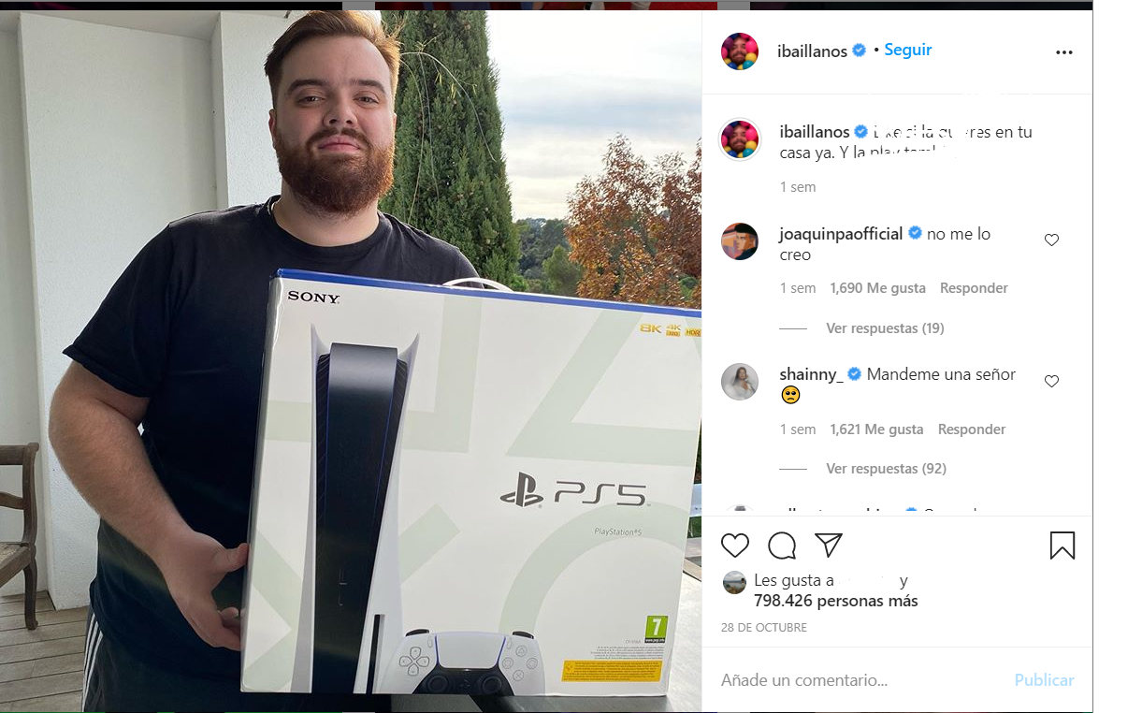
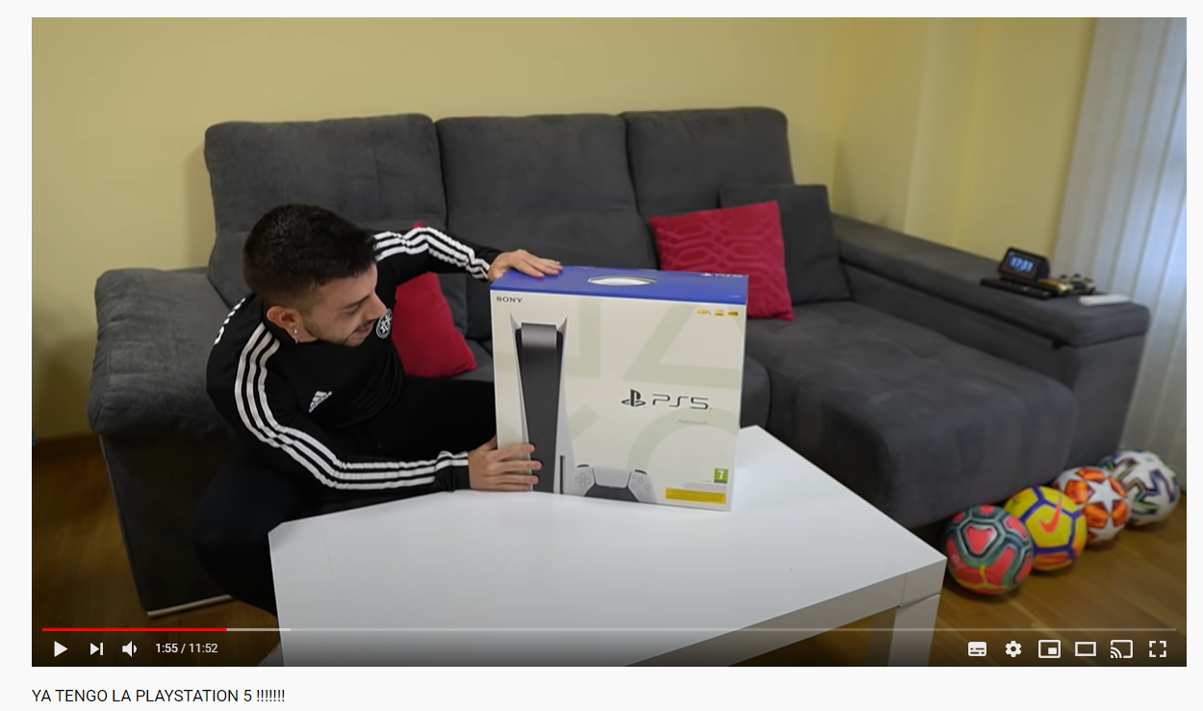

Platform: New generation of consoles PS, XBox
New generation of consoles launching dates
PS5: 19 November 2020
XBox Series X: 10 November 2020
Powerful marketing campaign to address gamers, especially teenagers
@ibaillanos | 4M subscribers
@DjMariio | 7M subscribers
@elrubiusOMG | 40M subscribers

Slide 13
Analysis
Target Market

Slide 14
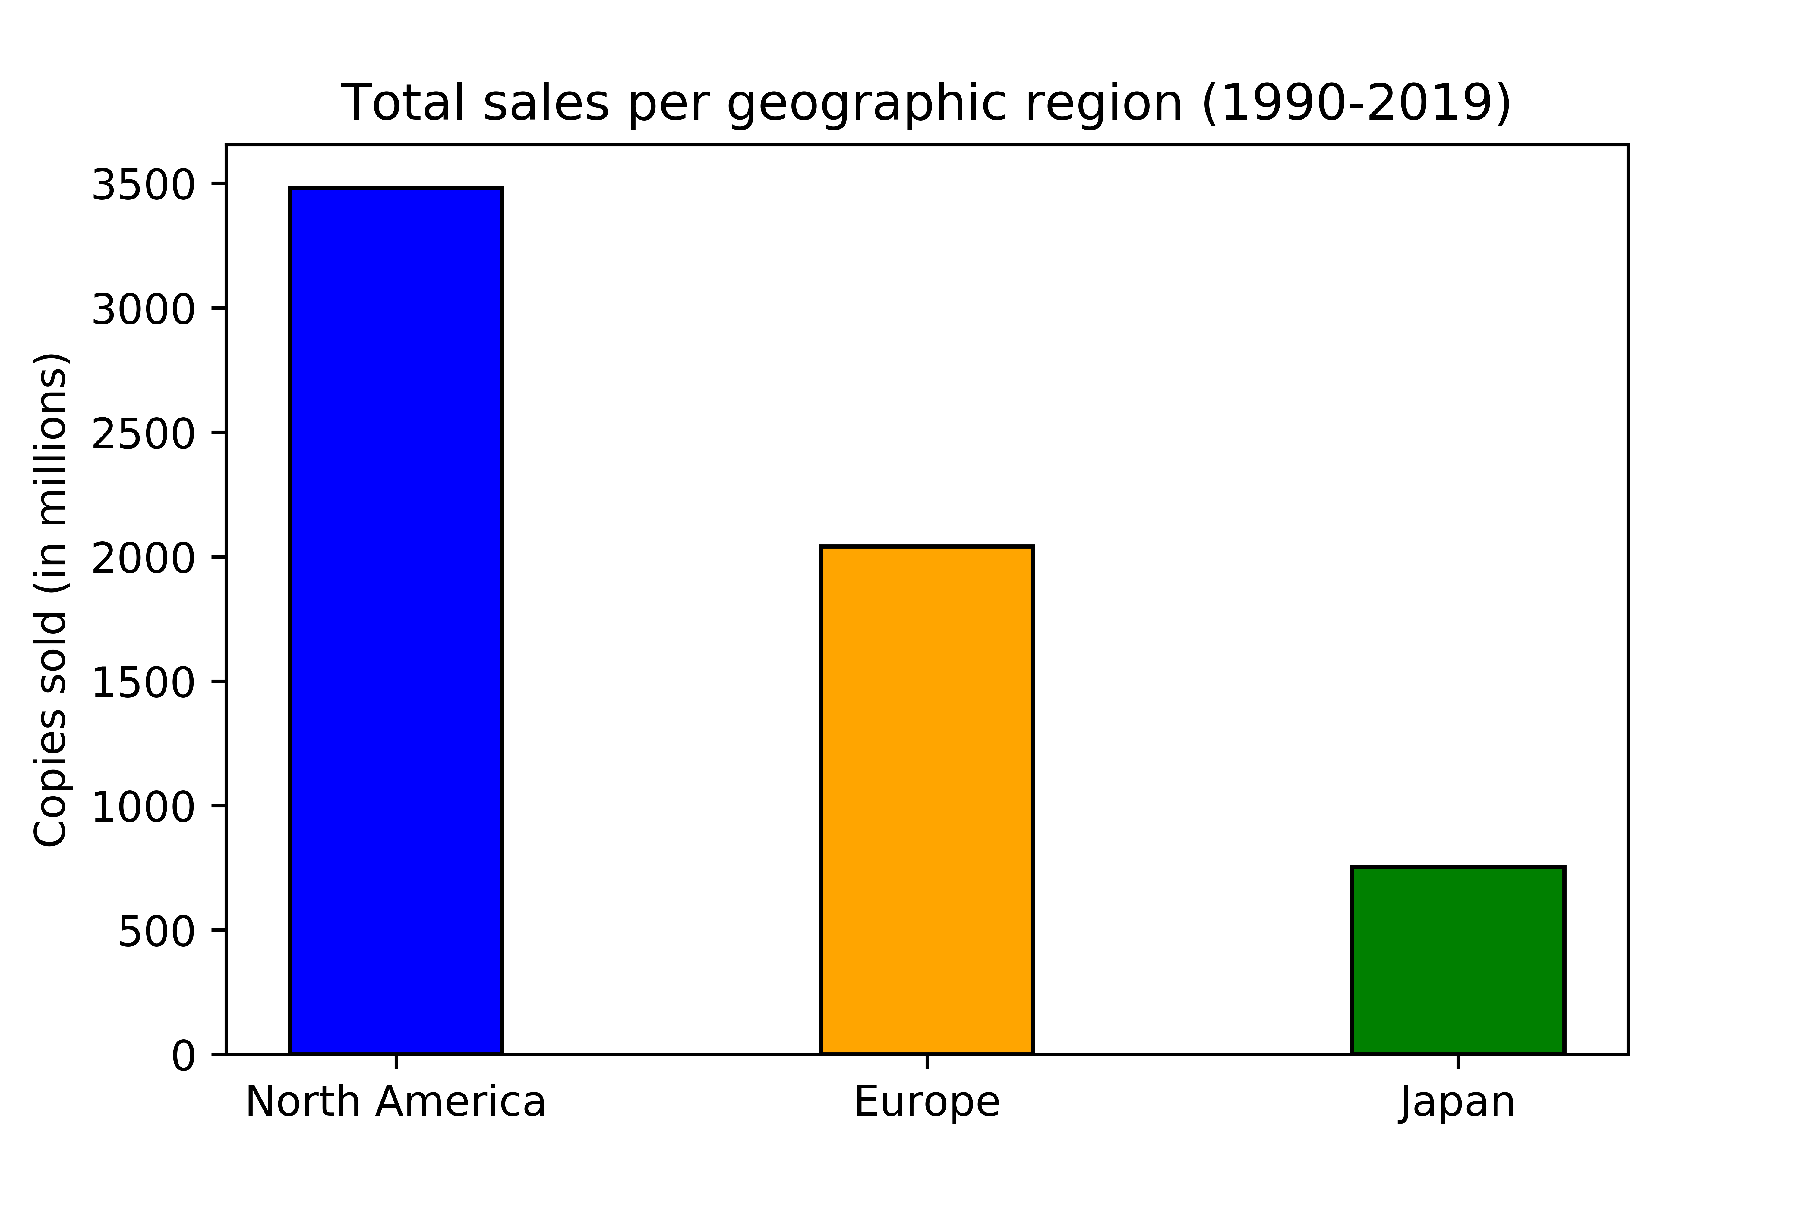
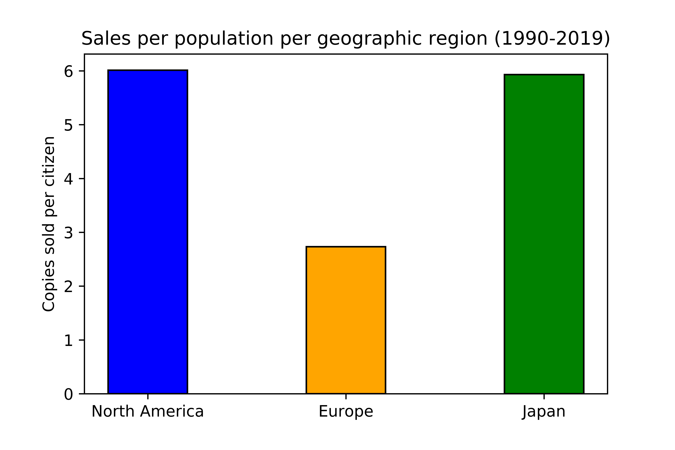
Geography: Which market is more attractive?
Population (in millions)
North America | Europe | Japan
579 | 747 | 127
North America: Most competitive market -> Big population and high consumption of videogames
Europe: Market opportunity -> Huge population but not as interested as NA or JP in videogame industry
Japan: competitive market but small one in comparison with EUR and NA (only 127mil pop.)
Sales will not distribute in the same way throughout the markets but all of them can offer us high sales

Slide 15
Analysis
Genre

Slide 16
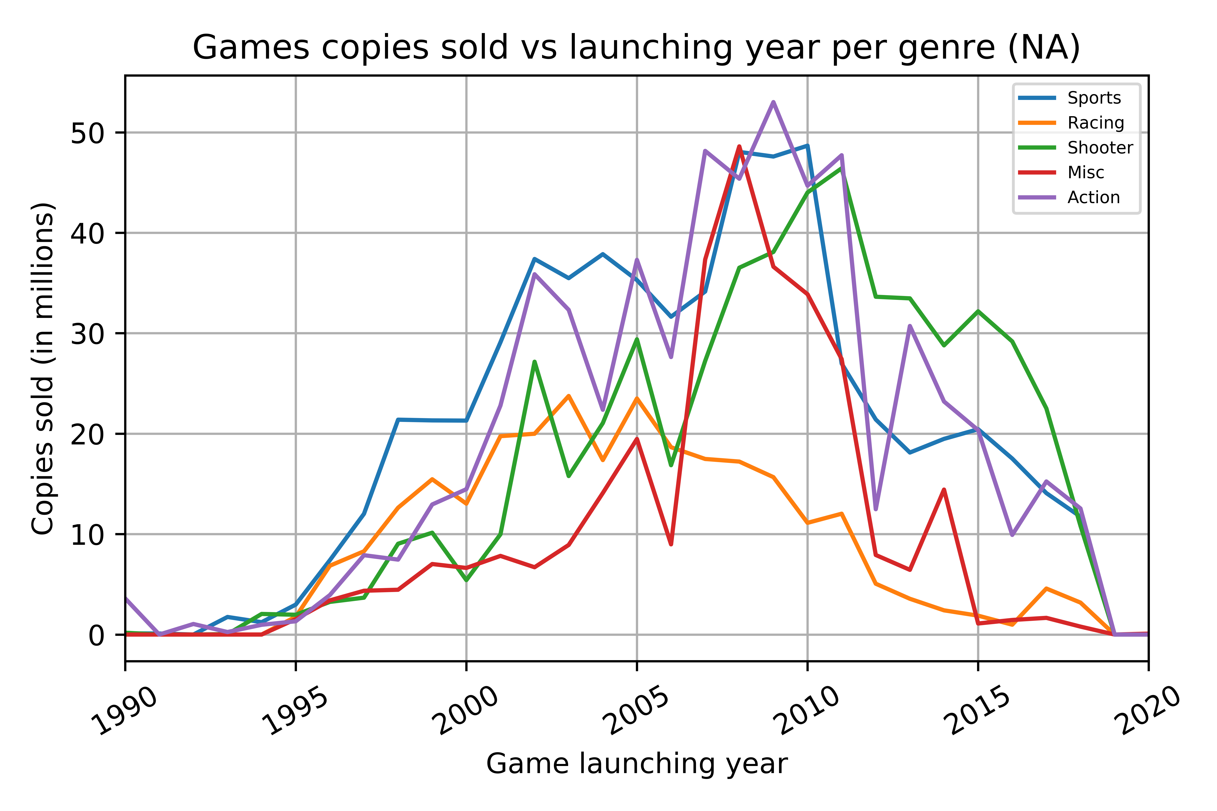
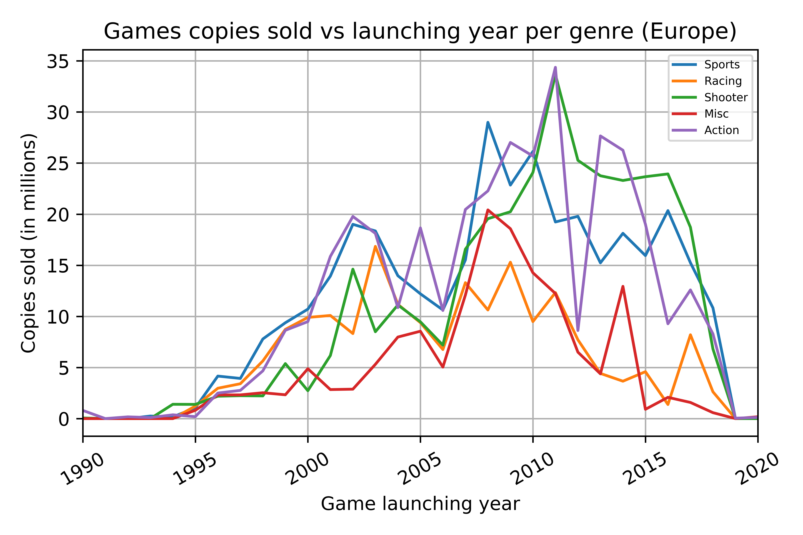
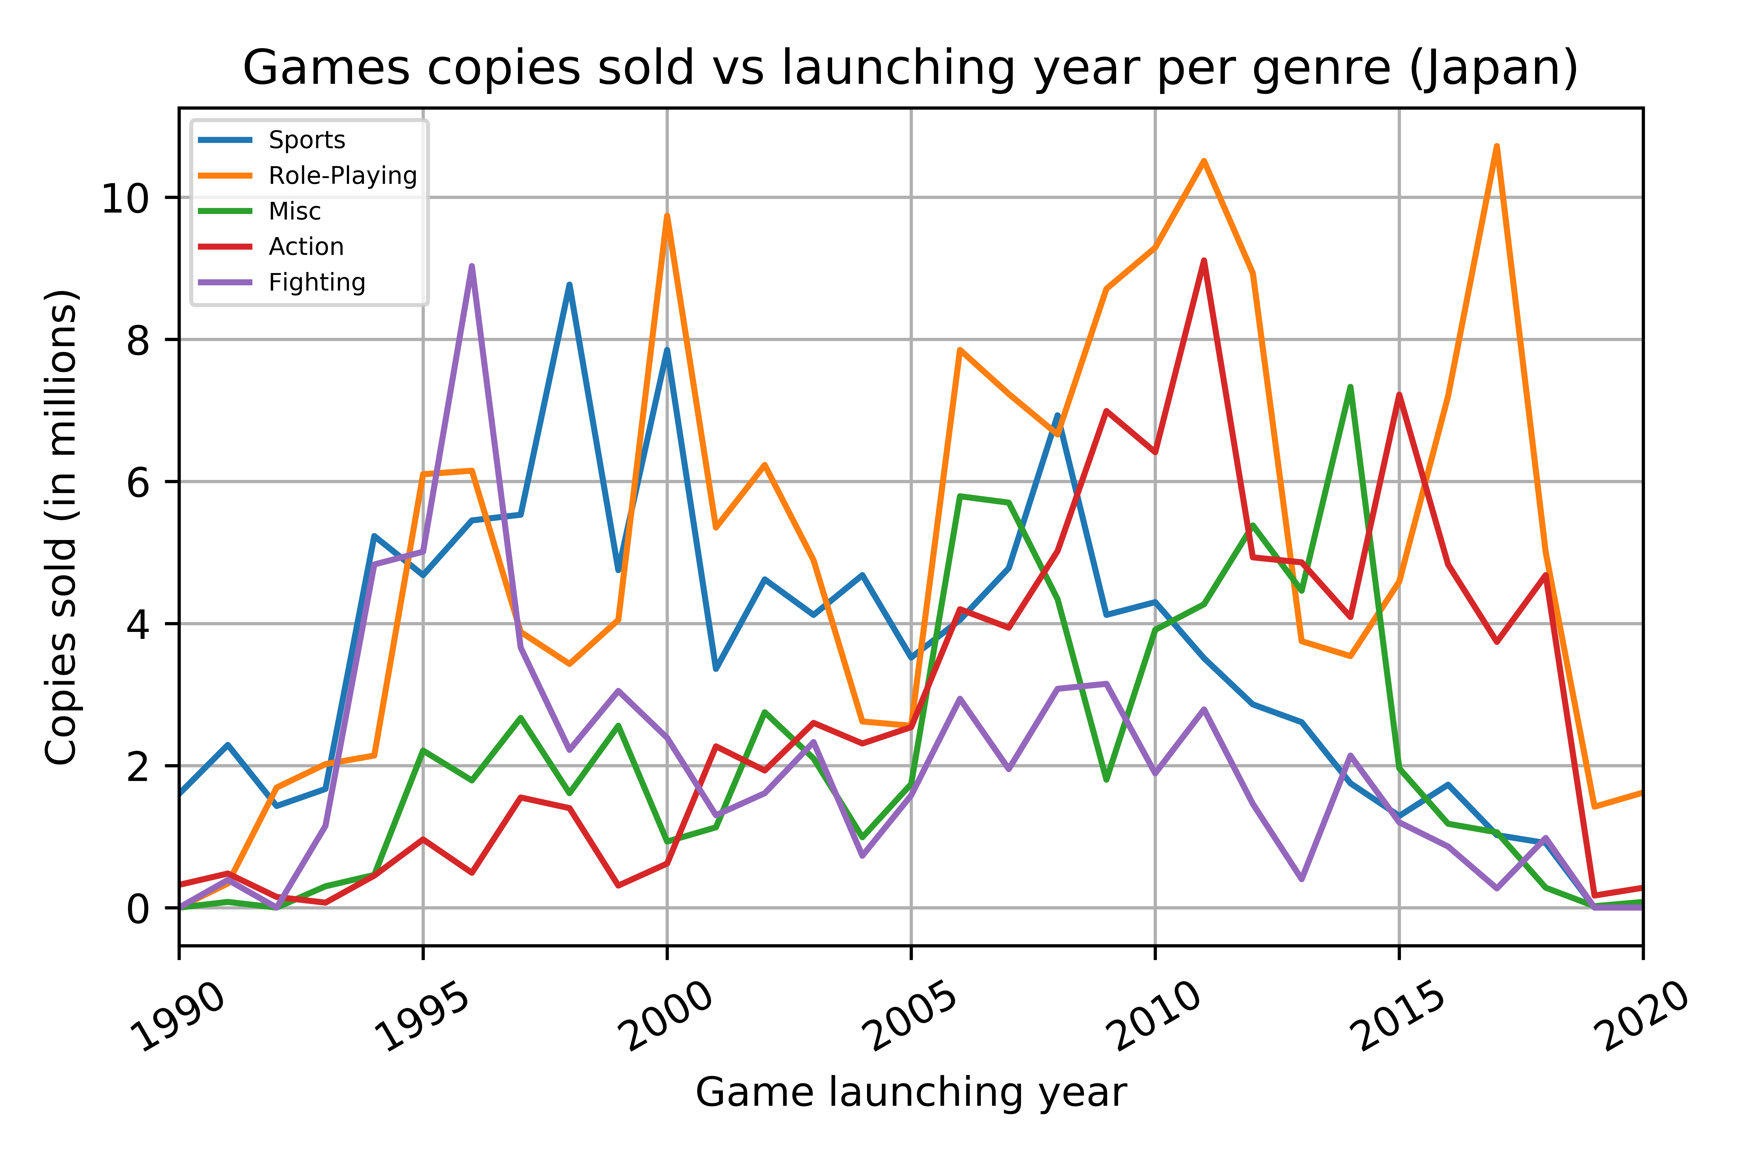
Genre: Which is the most competitive in all markets?
NA: Shooter dominates market from 2010 onwards. Previously Action and Sports big success
Europe: Action and Sports big historical success. From 2010 importance of Shooter very big
Japan: Role-playing genre has been clear dominator of market. Action competitive from 2010
European and NA markets trends are almost identical: similarity in cultures and interests
Action genre seems the best option to guarantee sales in all 3 markets

Slide 17
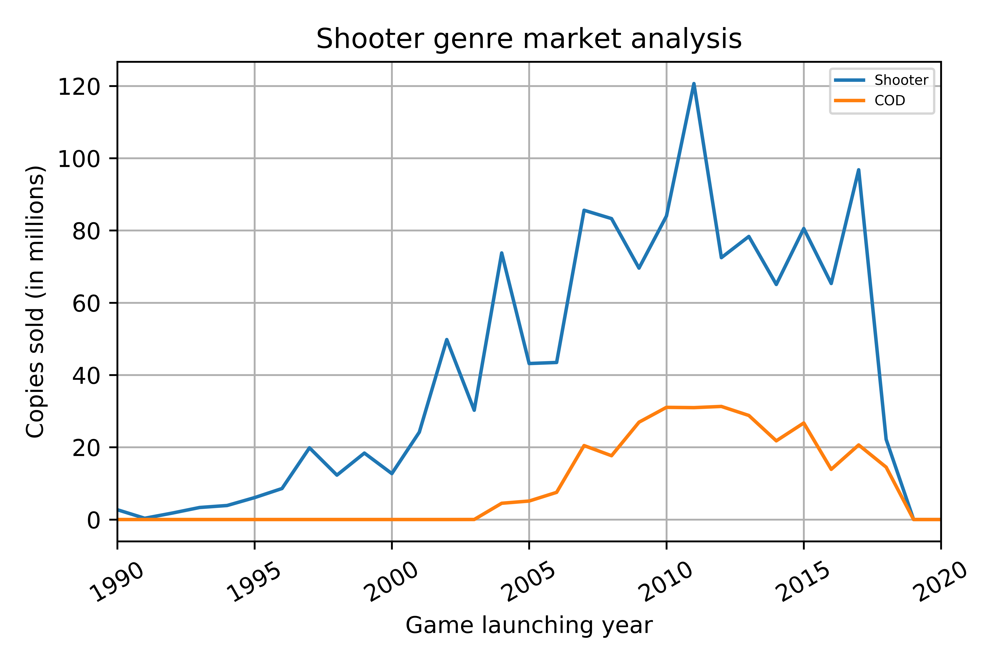
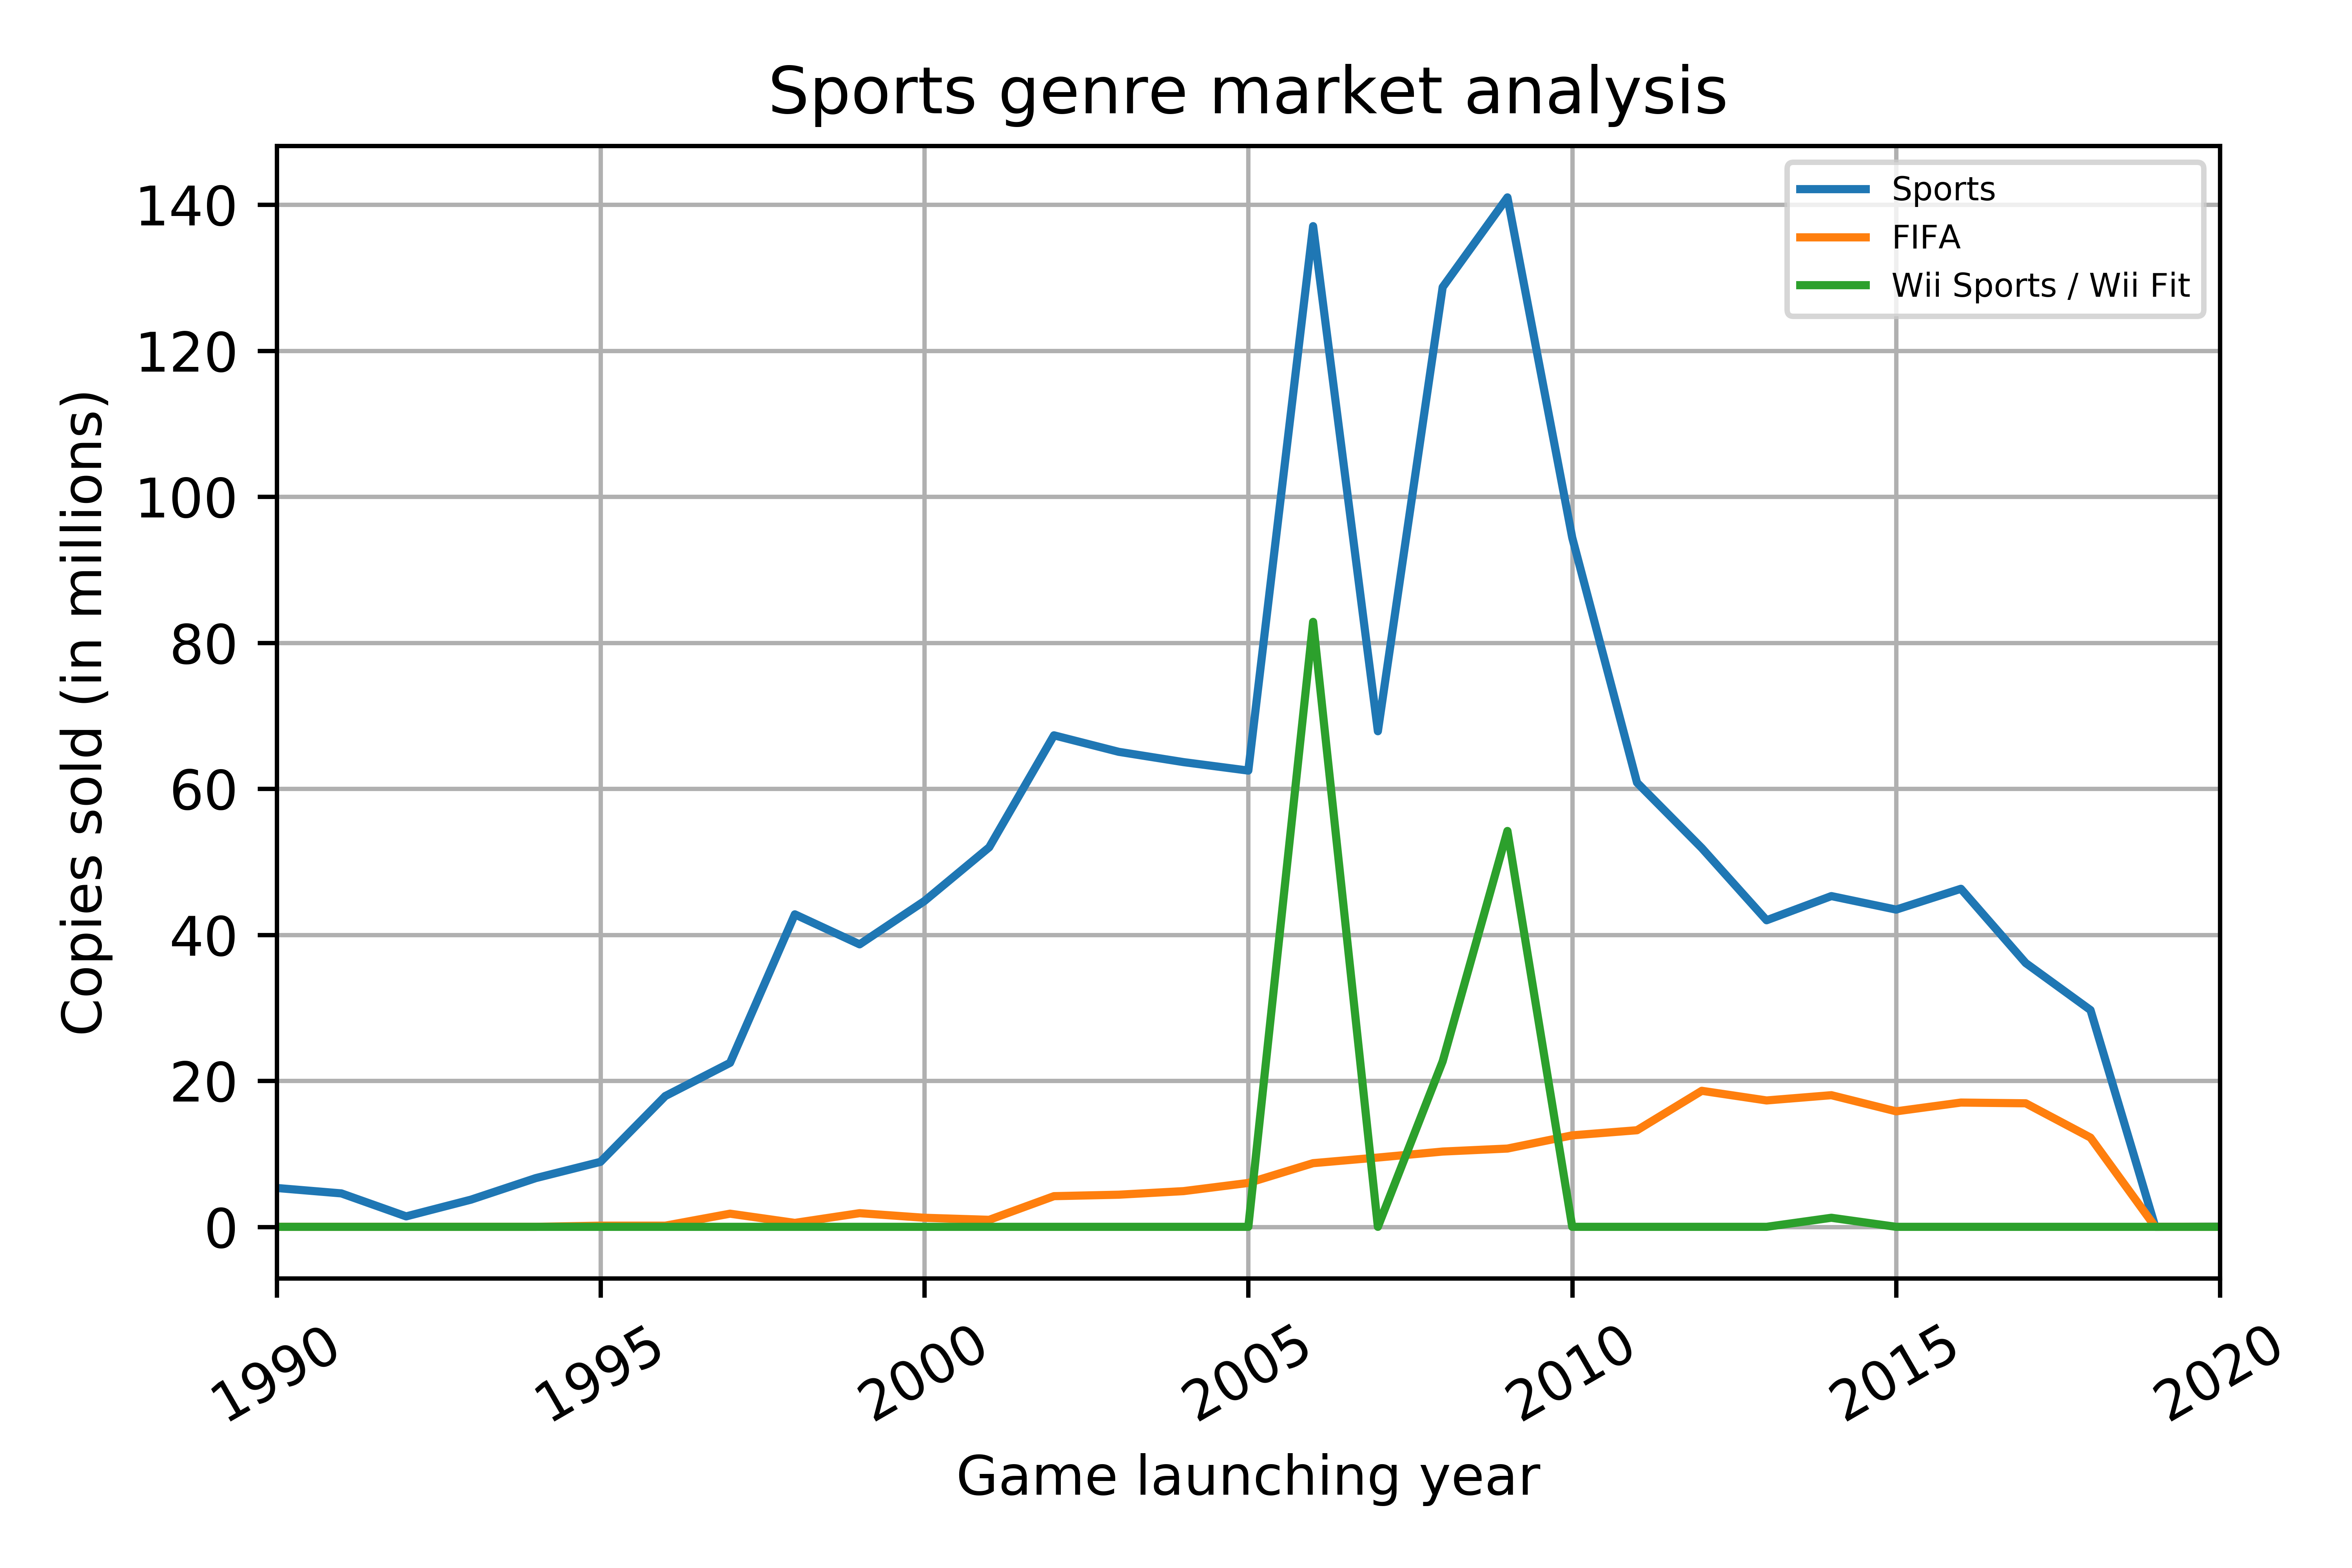
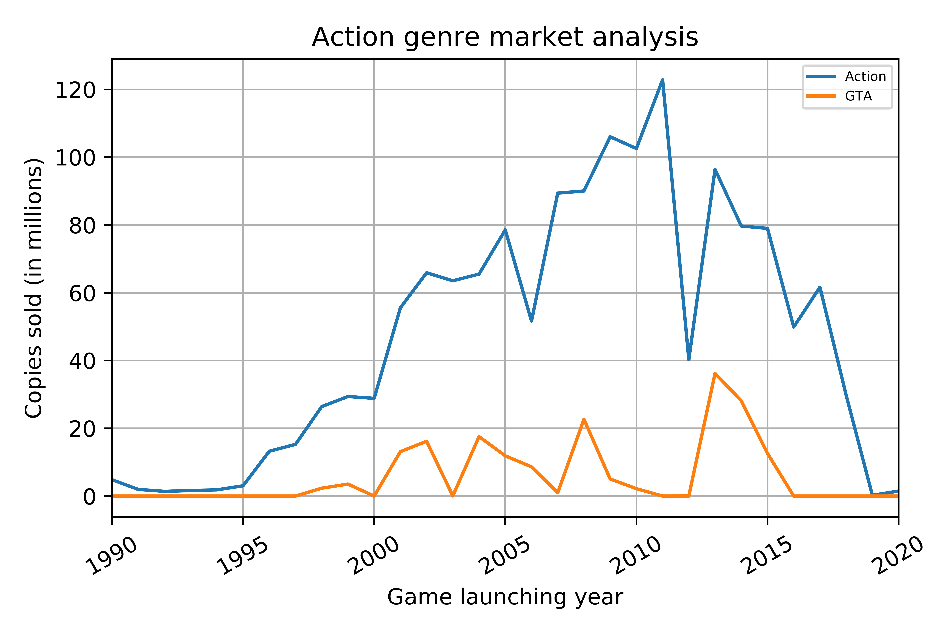
Genre: Competition
Name | No Games | 1st Publication | Last Publication
Call of Duty | 74 | 2003 | 2018
Name | No Games | 1st Publication | Last Publication
FIFA | 151 | 1995 | 2018
Name | No Games | 1st Publication | Last Publication
Grand Theft Auto | 36 | 1998 | 2015
Shooter: Call of Duty big dominant of market. Very hard competition: continuous releases of games in 2003-2018 and very high sales
Sports: FIFA has completely dominated market from 2010: represents almost 50% of Sports sales
Action: Grand Theft Auto has had big success but its sales and game releases have been intermittent; last game launched in 2015. Best market opportunity

Slide 18
Analysis
ESRB Rating

Slide 19
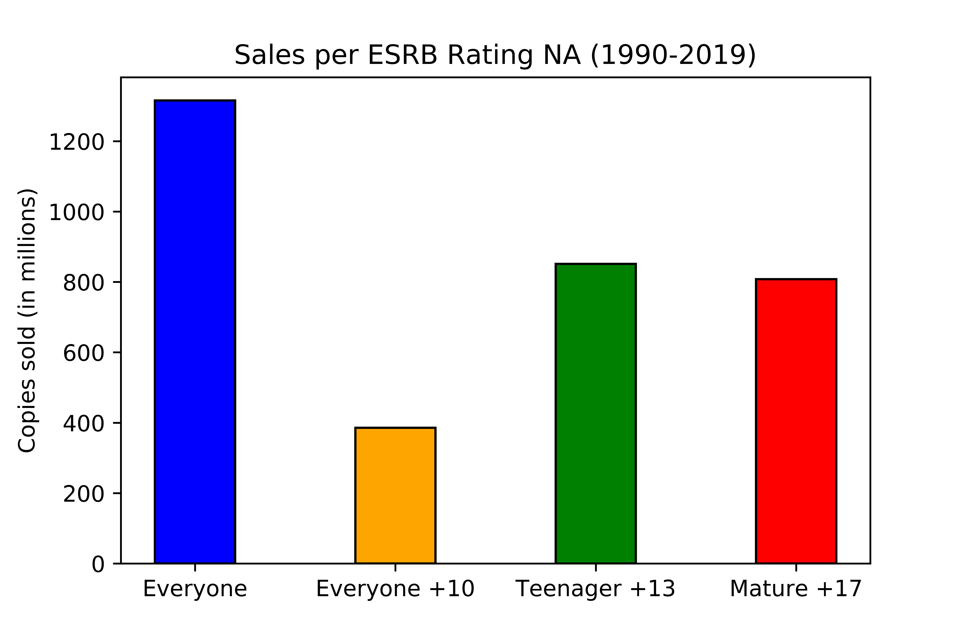
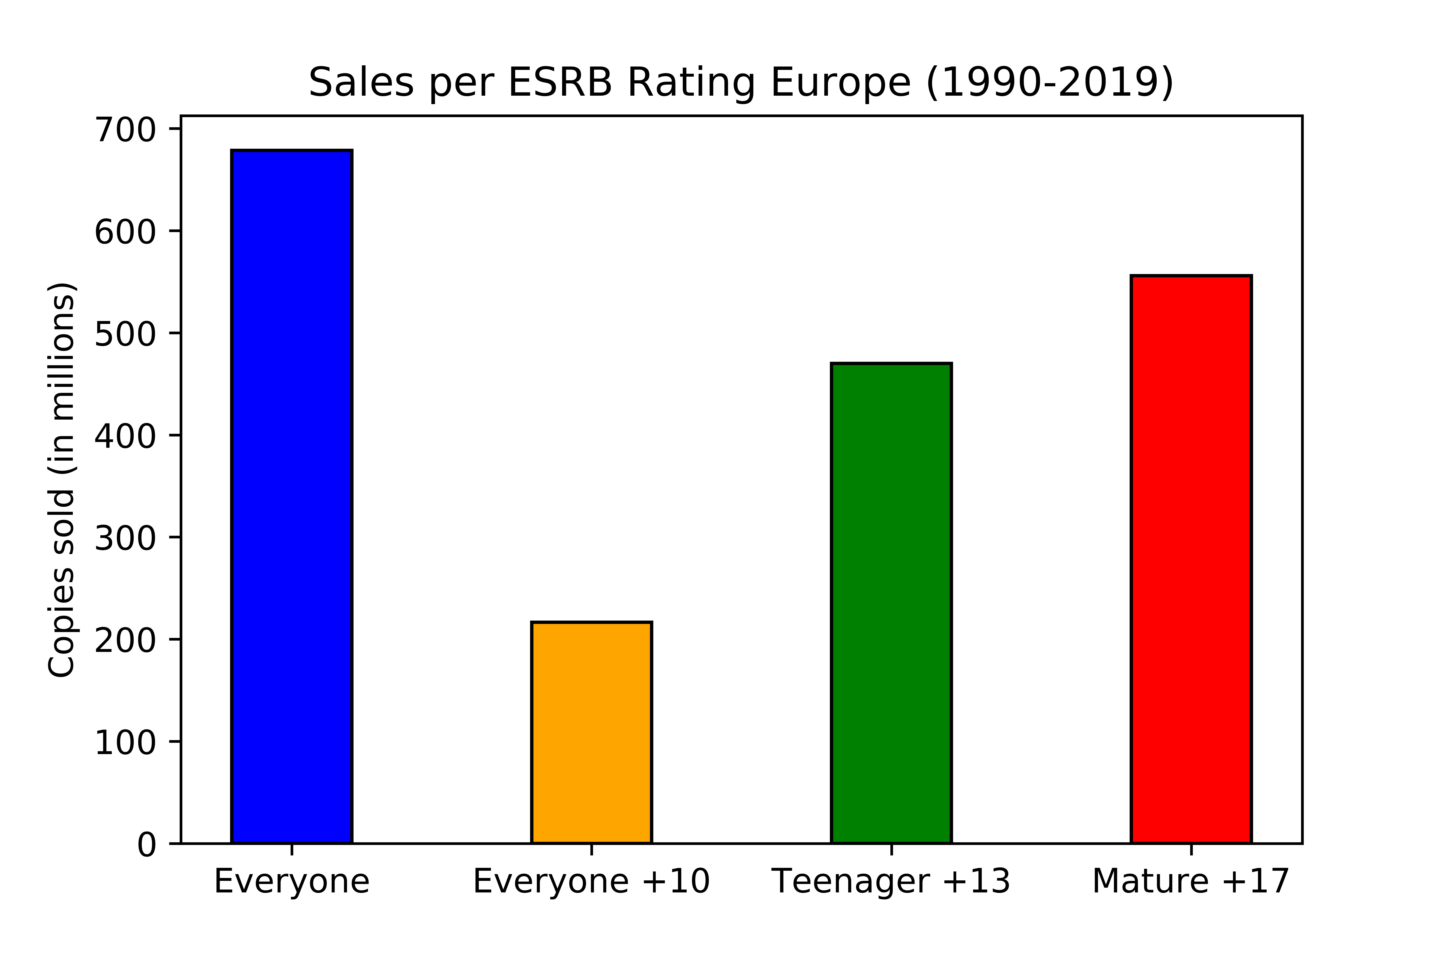
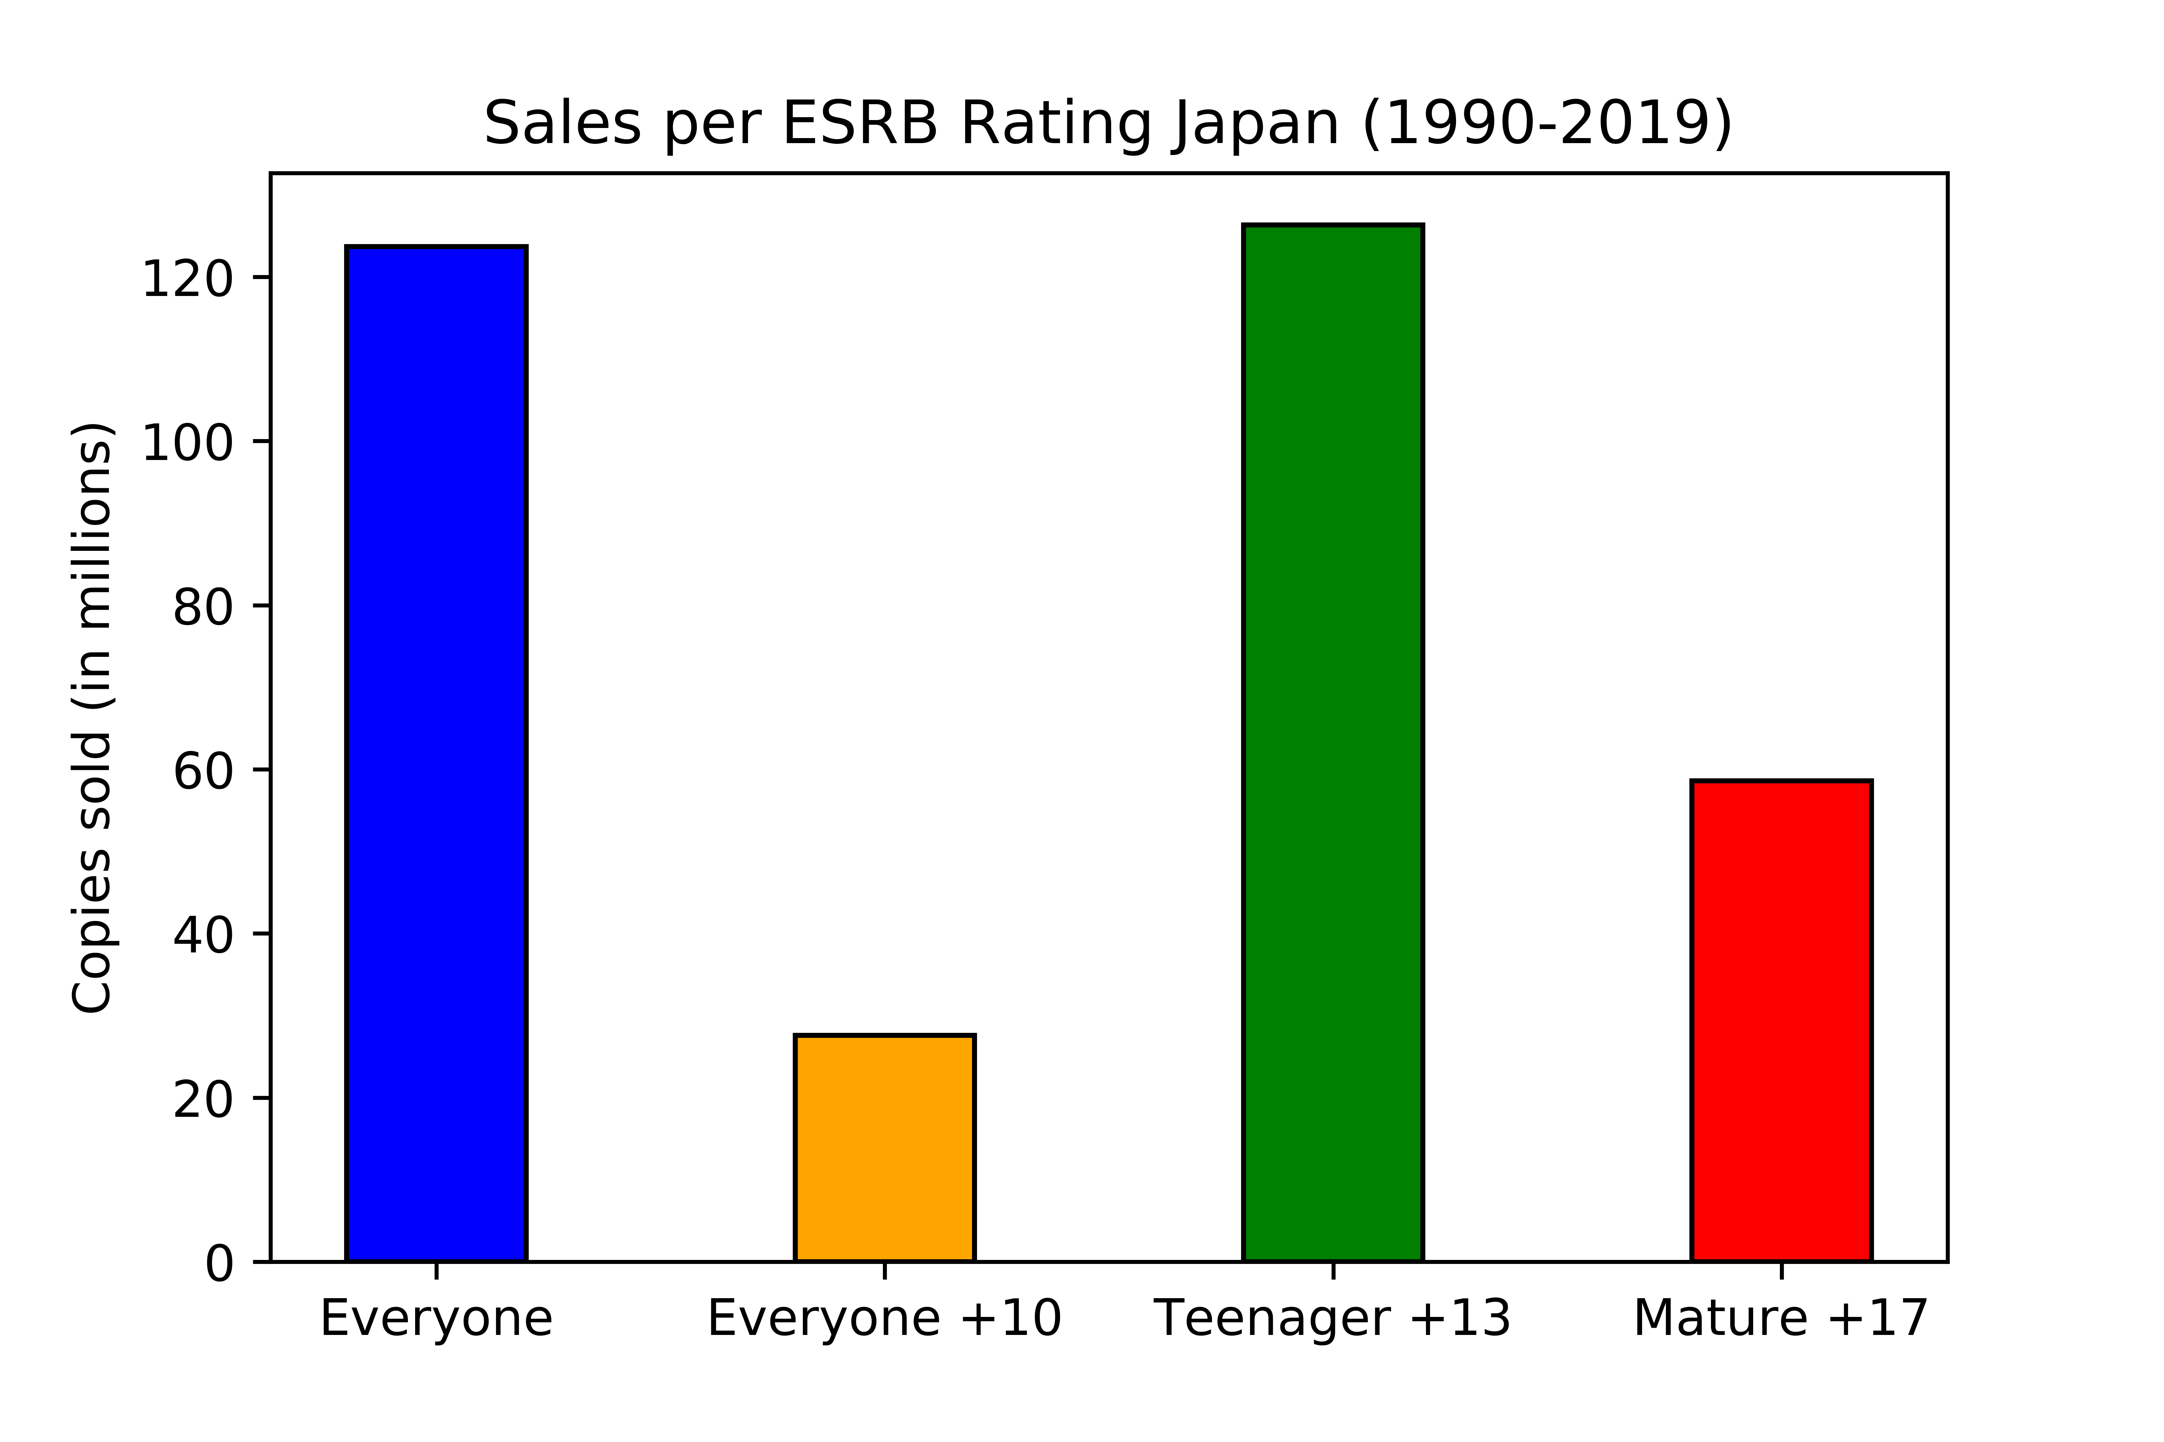
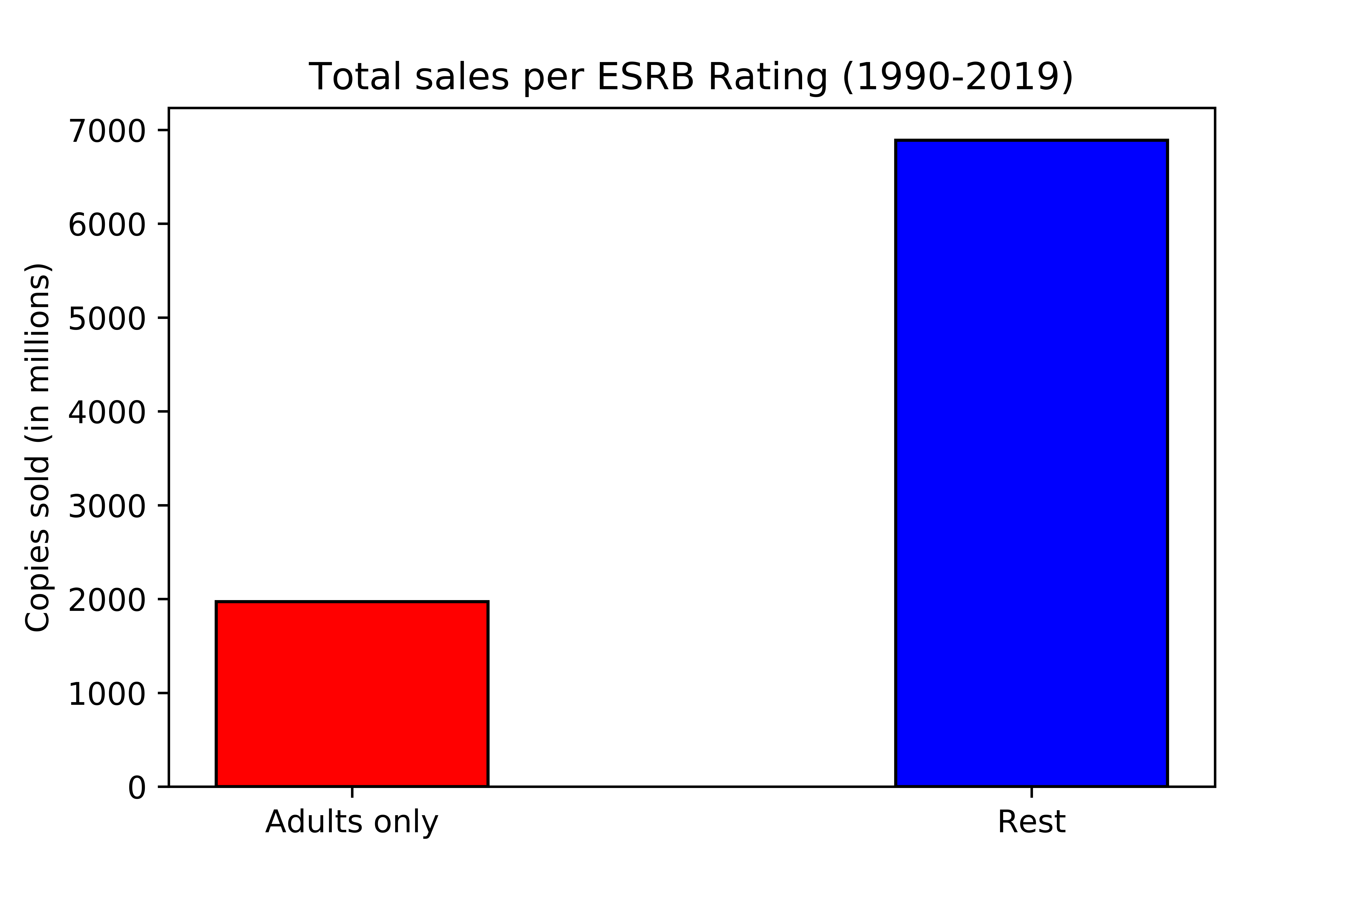
ESRB Rating: Which rating obtains more sales?
Games not rated as Adults Only (E, E10, T13) present much higher sales
Better to not have a Mature +17 rating
Teenager +13: not too childish, teenagers can still play

Slide 20
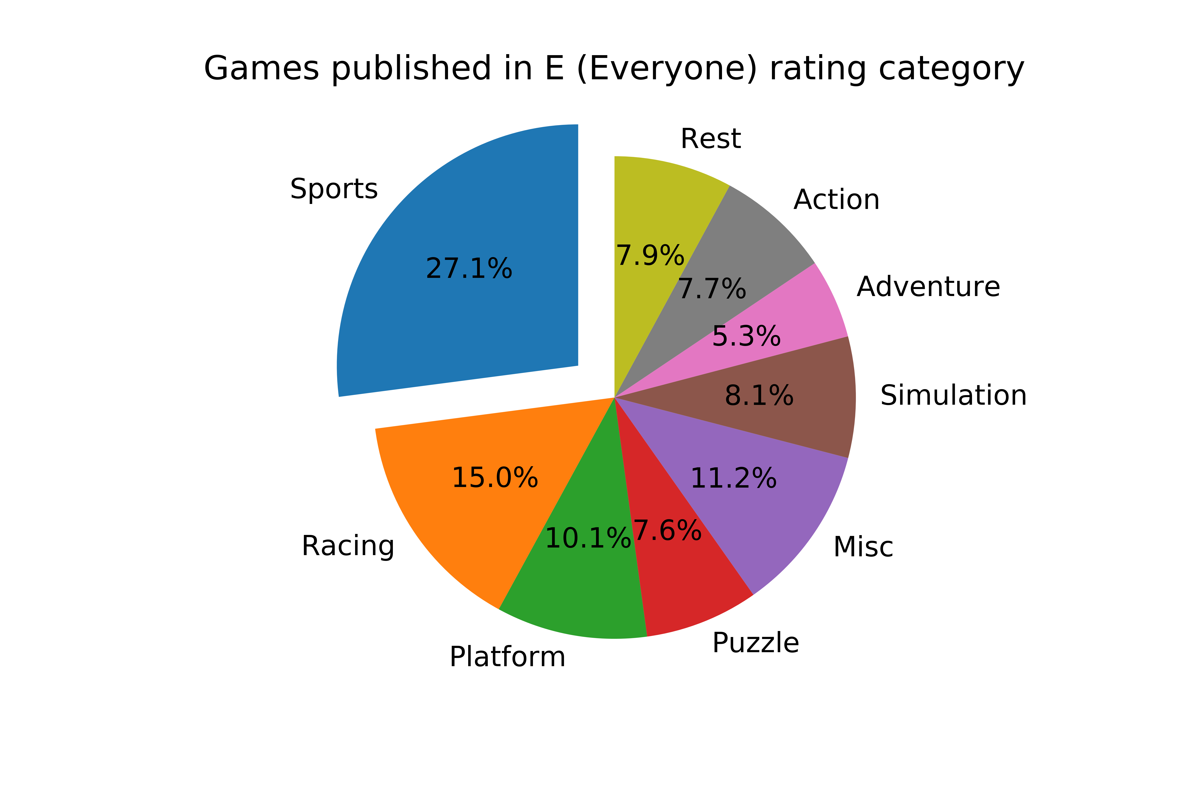
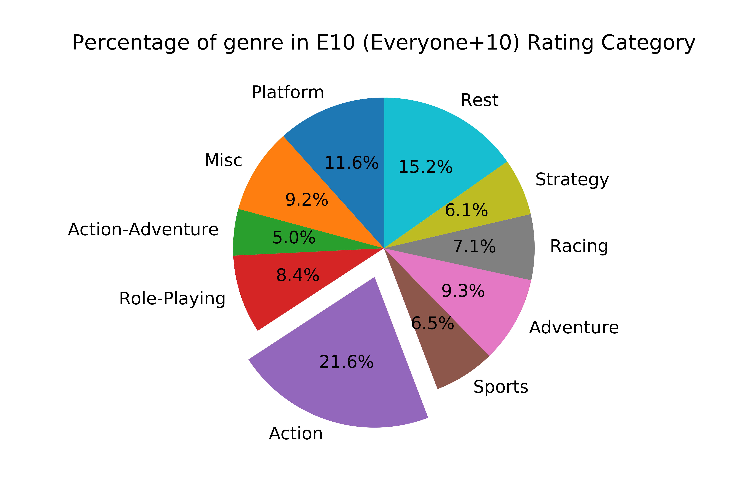
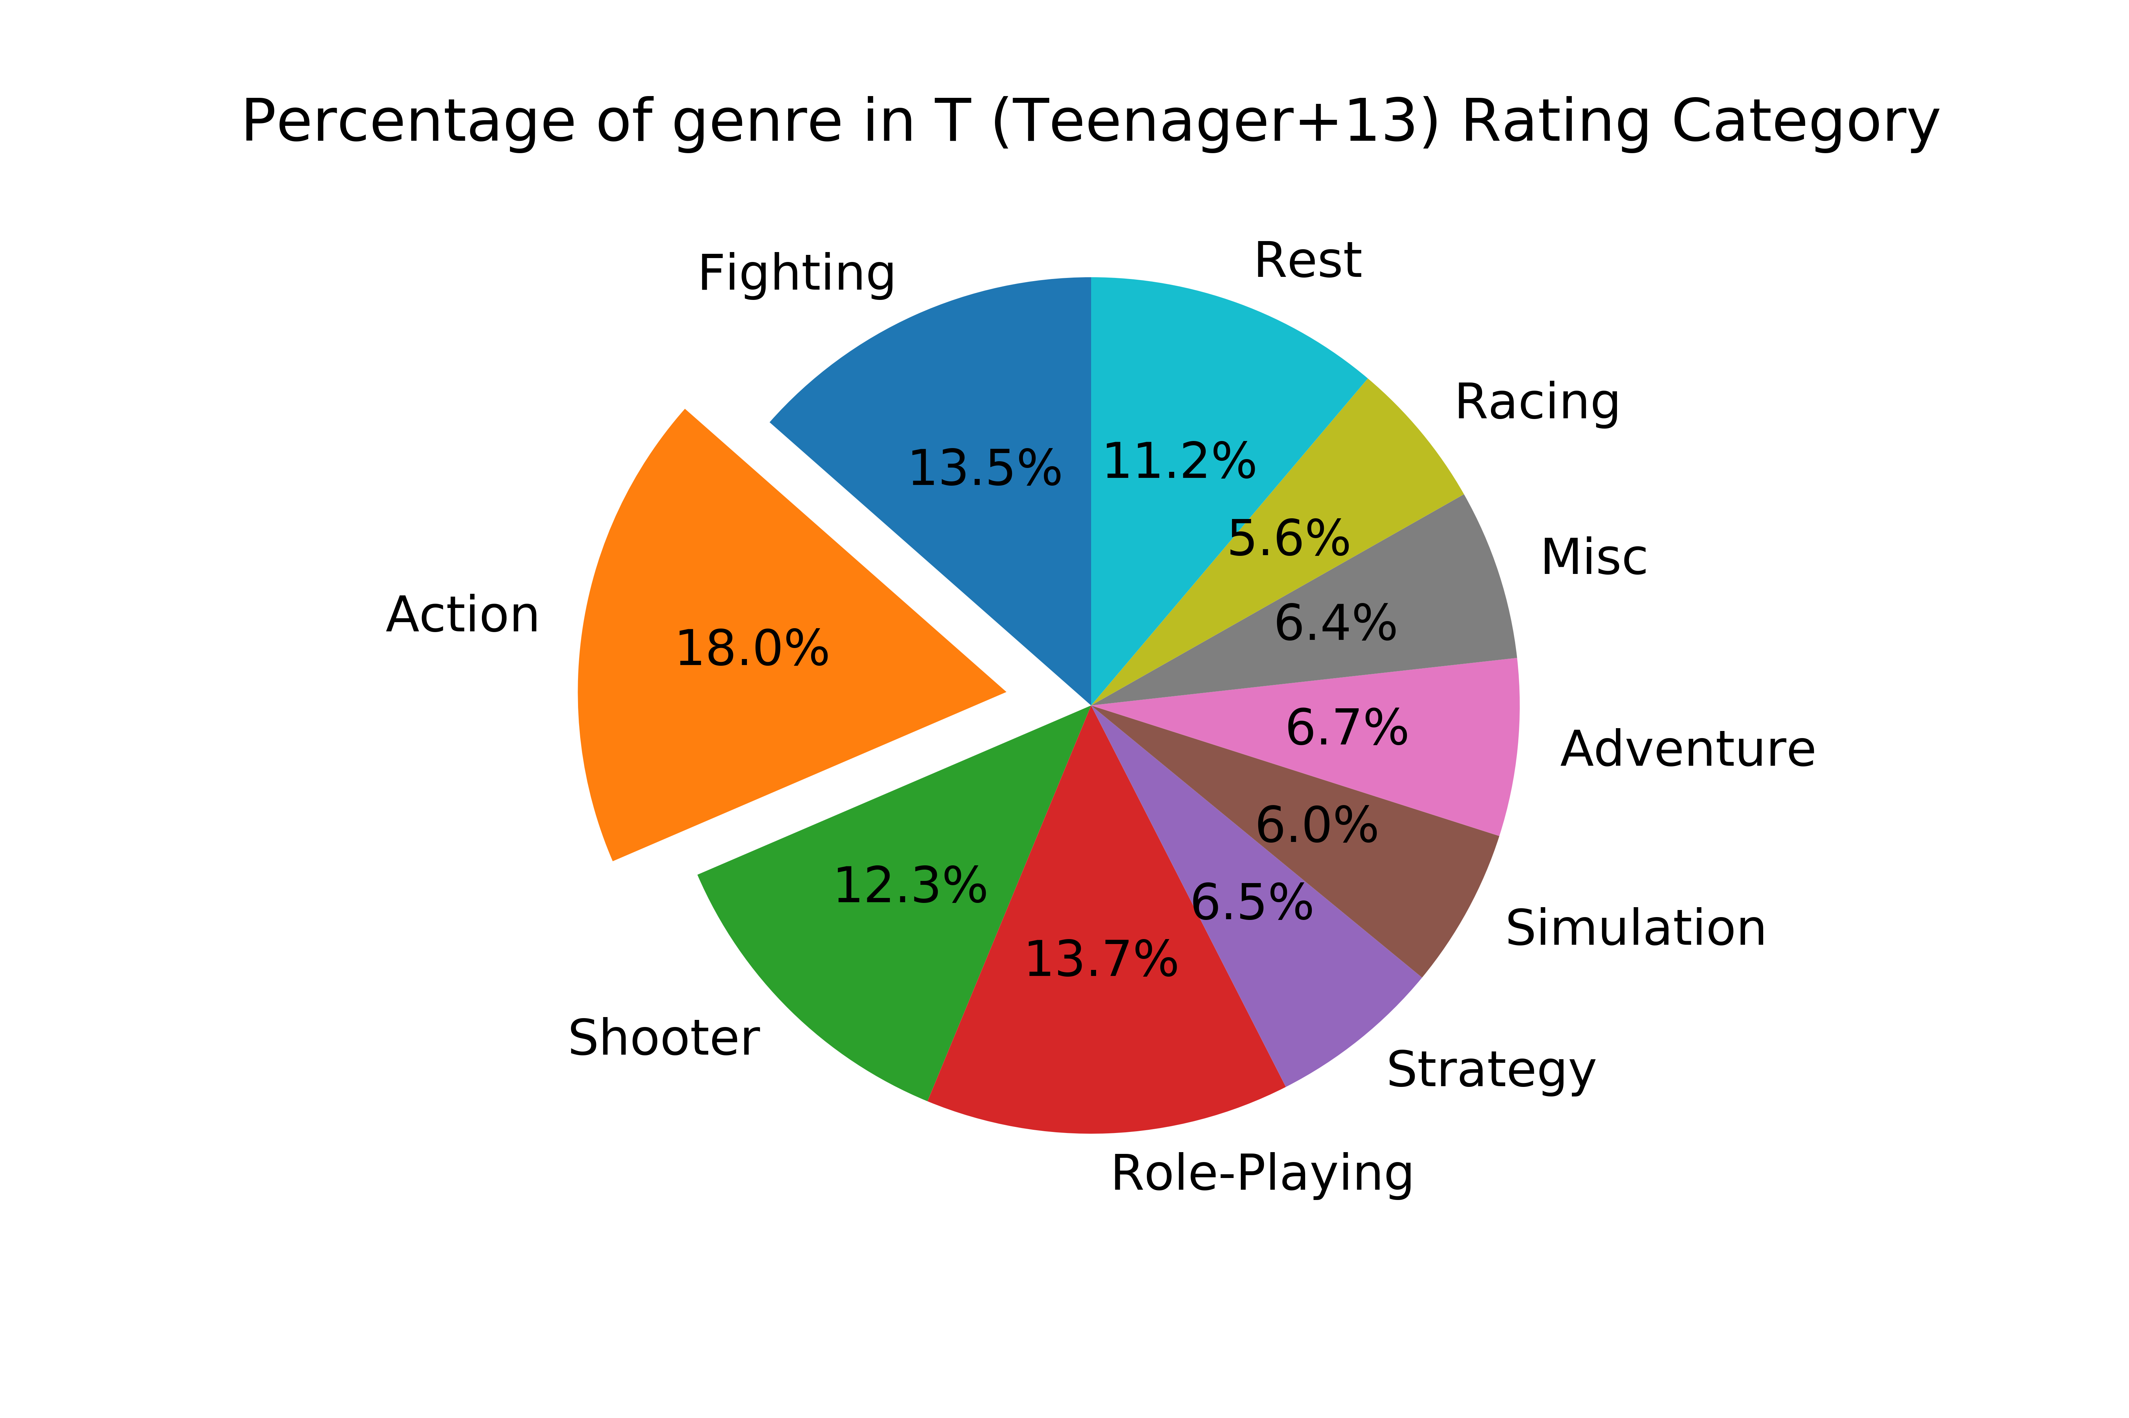
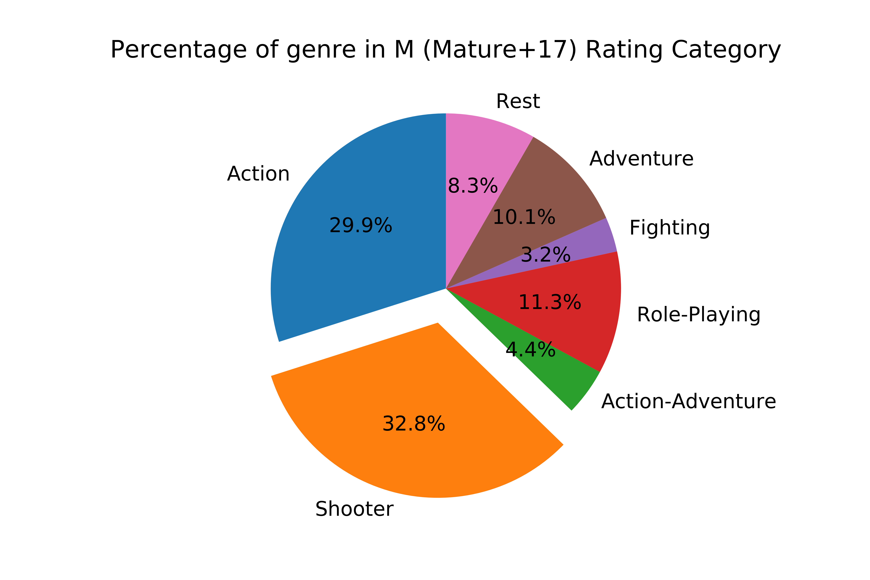
ESRB Rating: Which genres are more prominent for each rating?
Sports: most games are rated for “Everyone”
Shooter: most games are rated for “Mature +17”
Action: presents an important amount of games in E10, T+13, M+17 categories
Action: seems the better genre to accommodate all ages

Slide 21
Analysis
Publisher

Slide 22
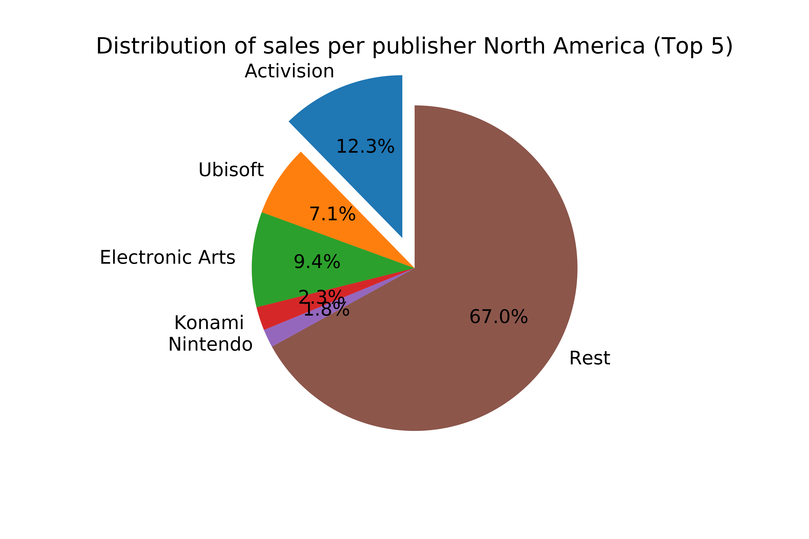
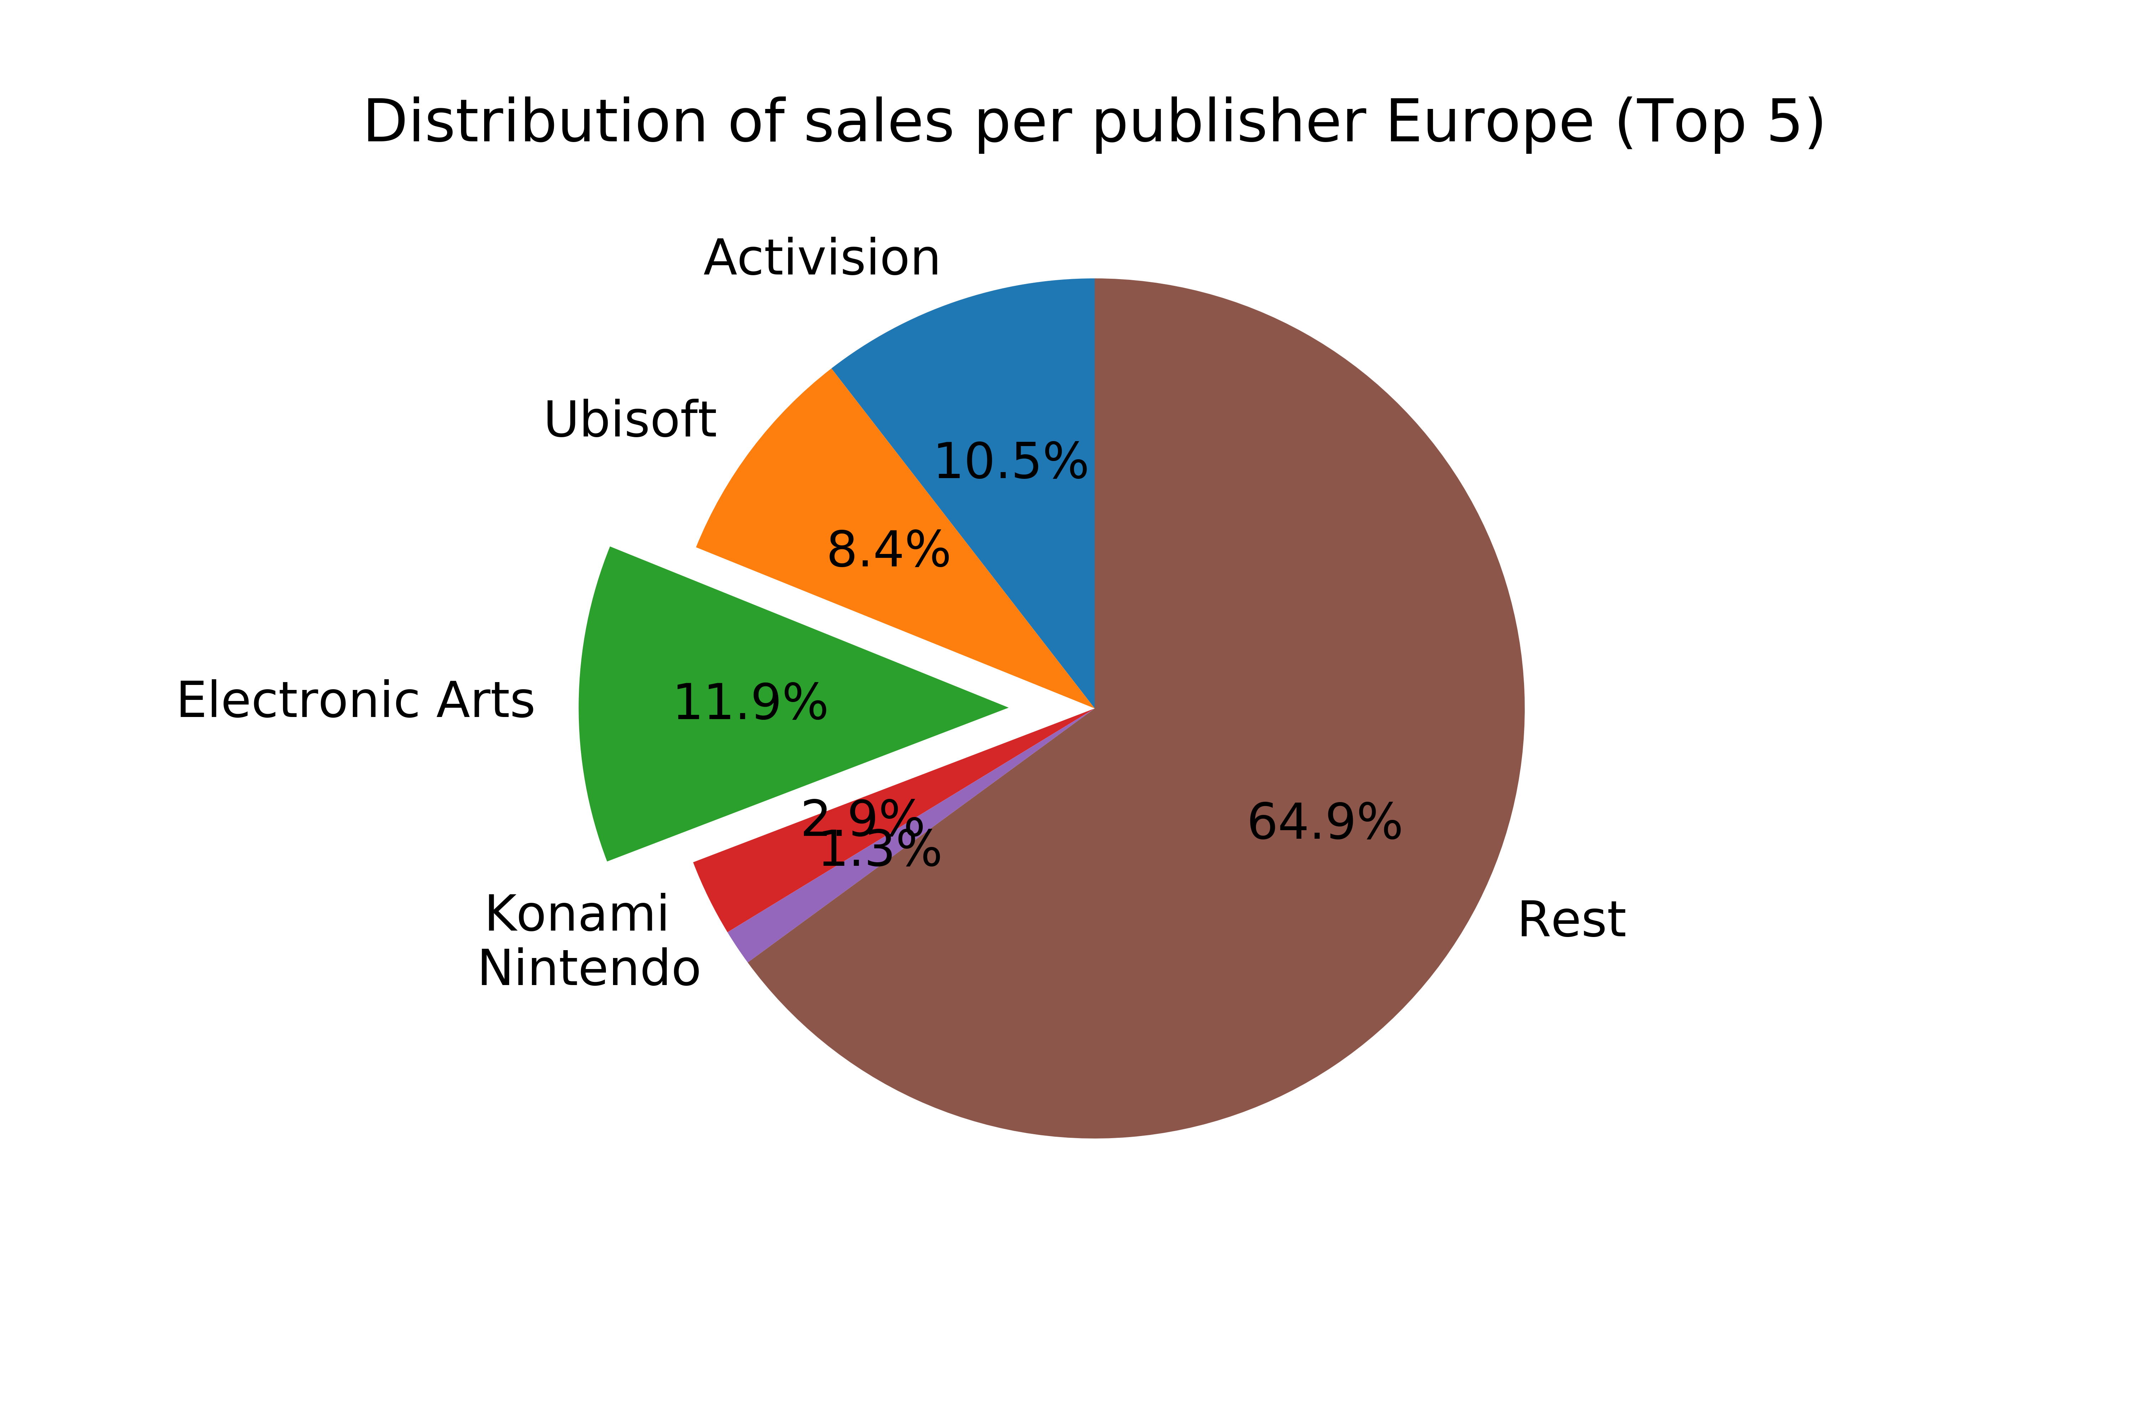
Publisher: North America & European markets
Publisher trends in NA and European Markets are very similar
3 main options: Activision, Ubisoft, Electronic Arts
Since NA is a bigger market than Europe, Activision distributor seems the best choice and selected for further analysis

Slide 23
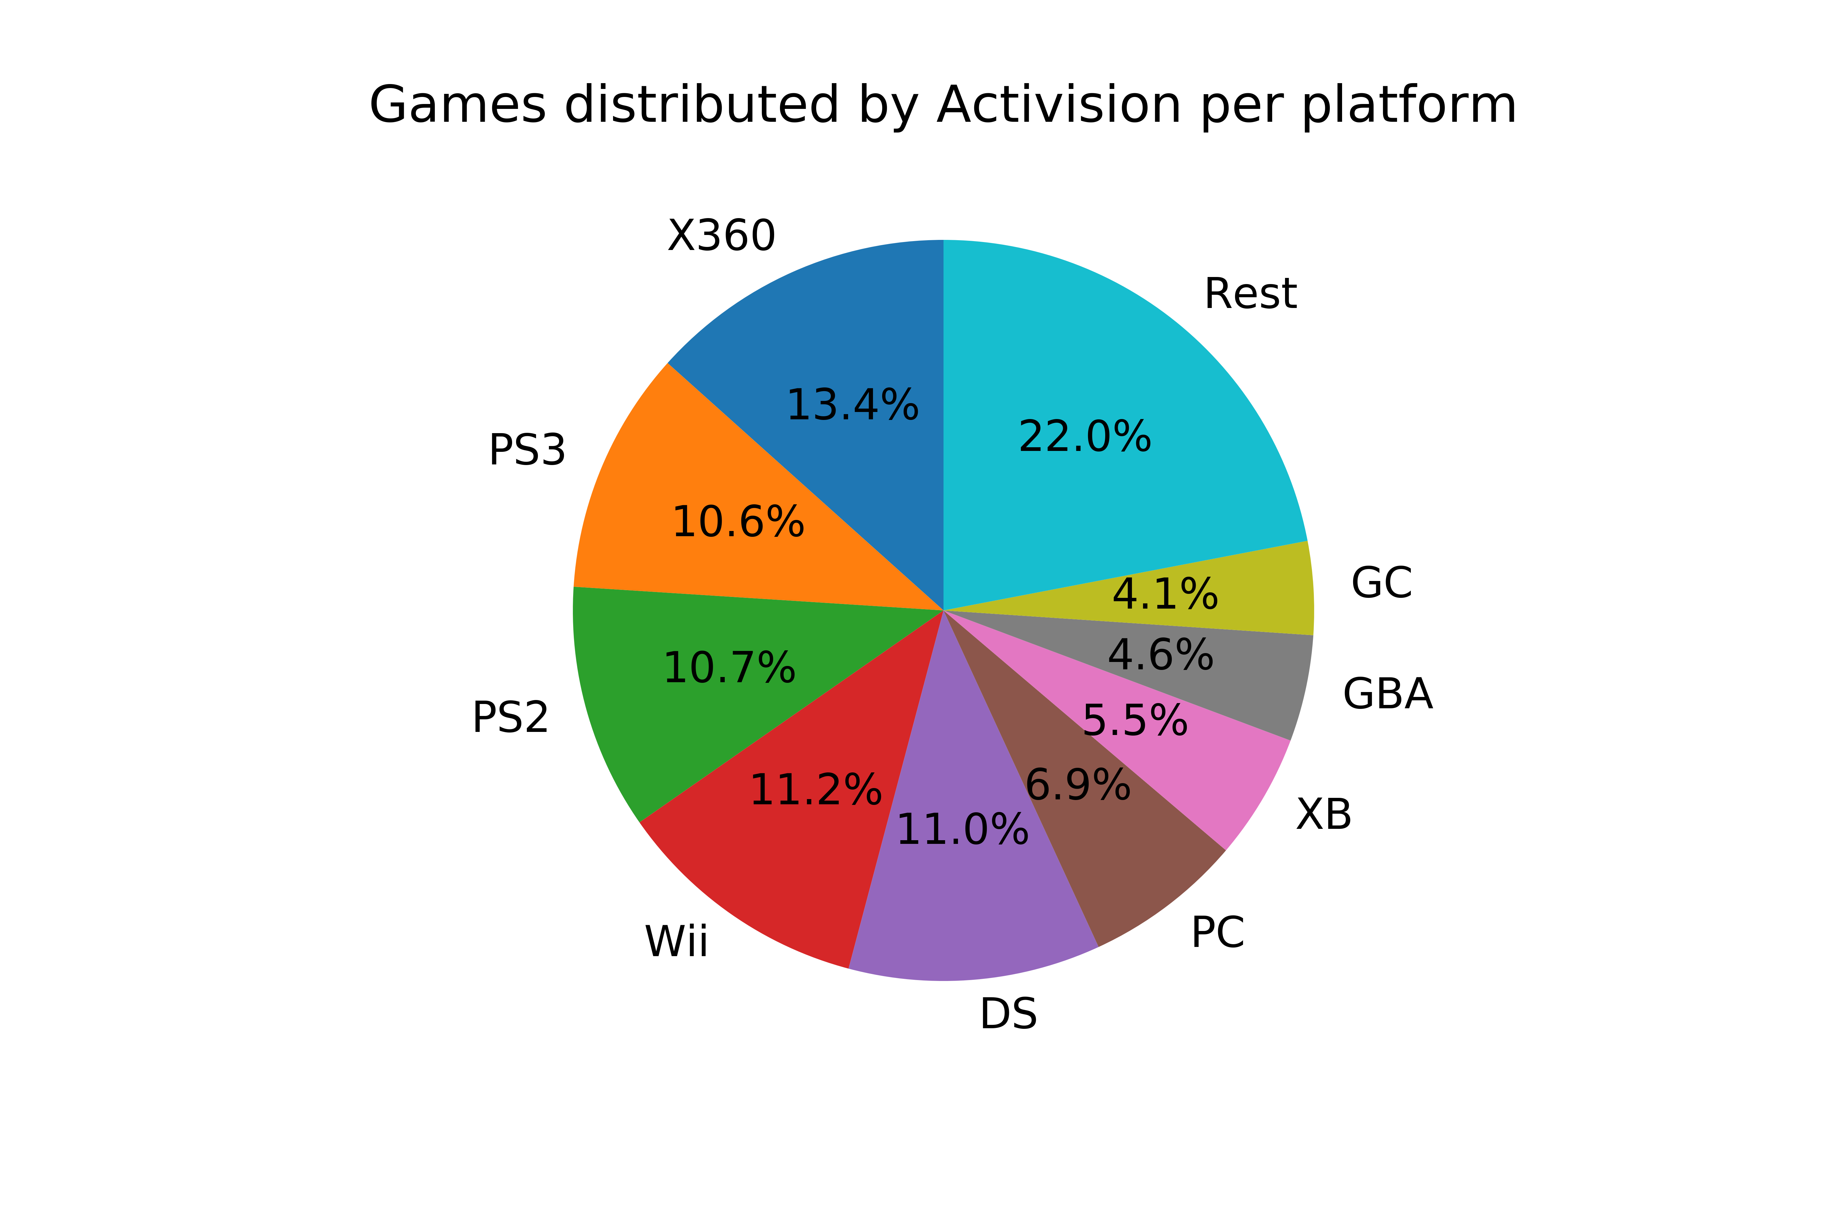
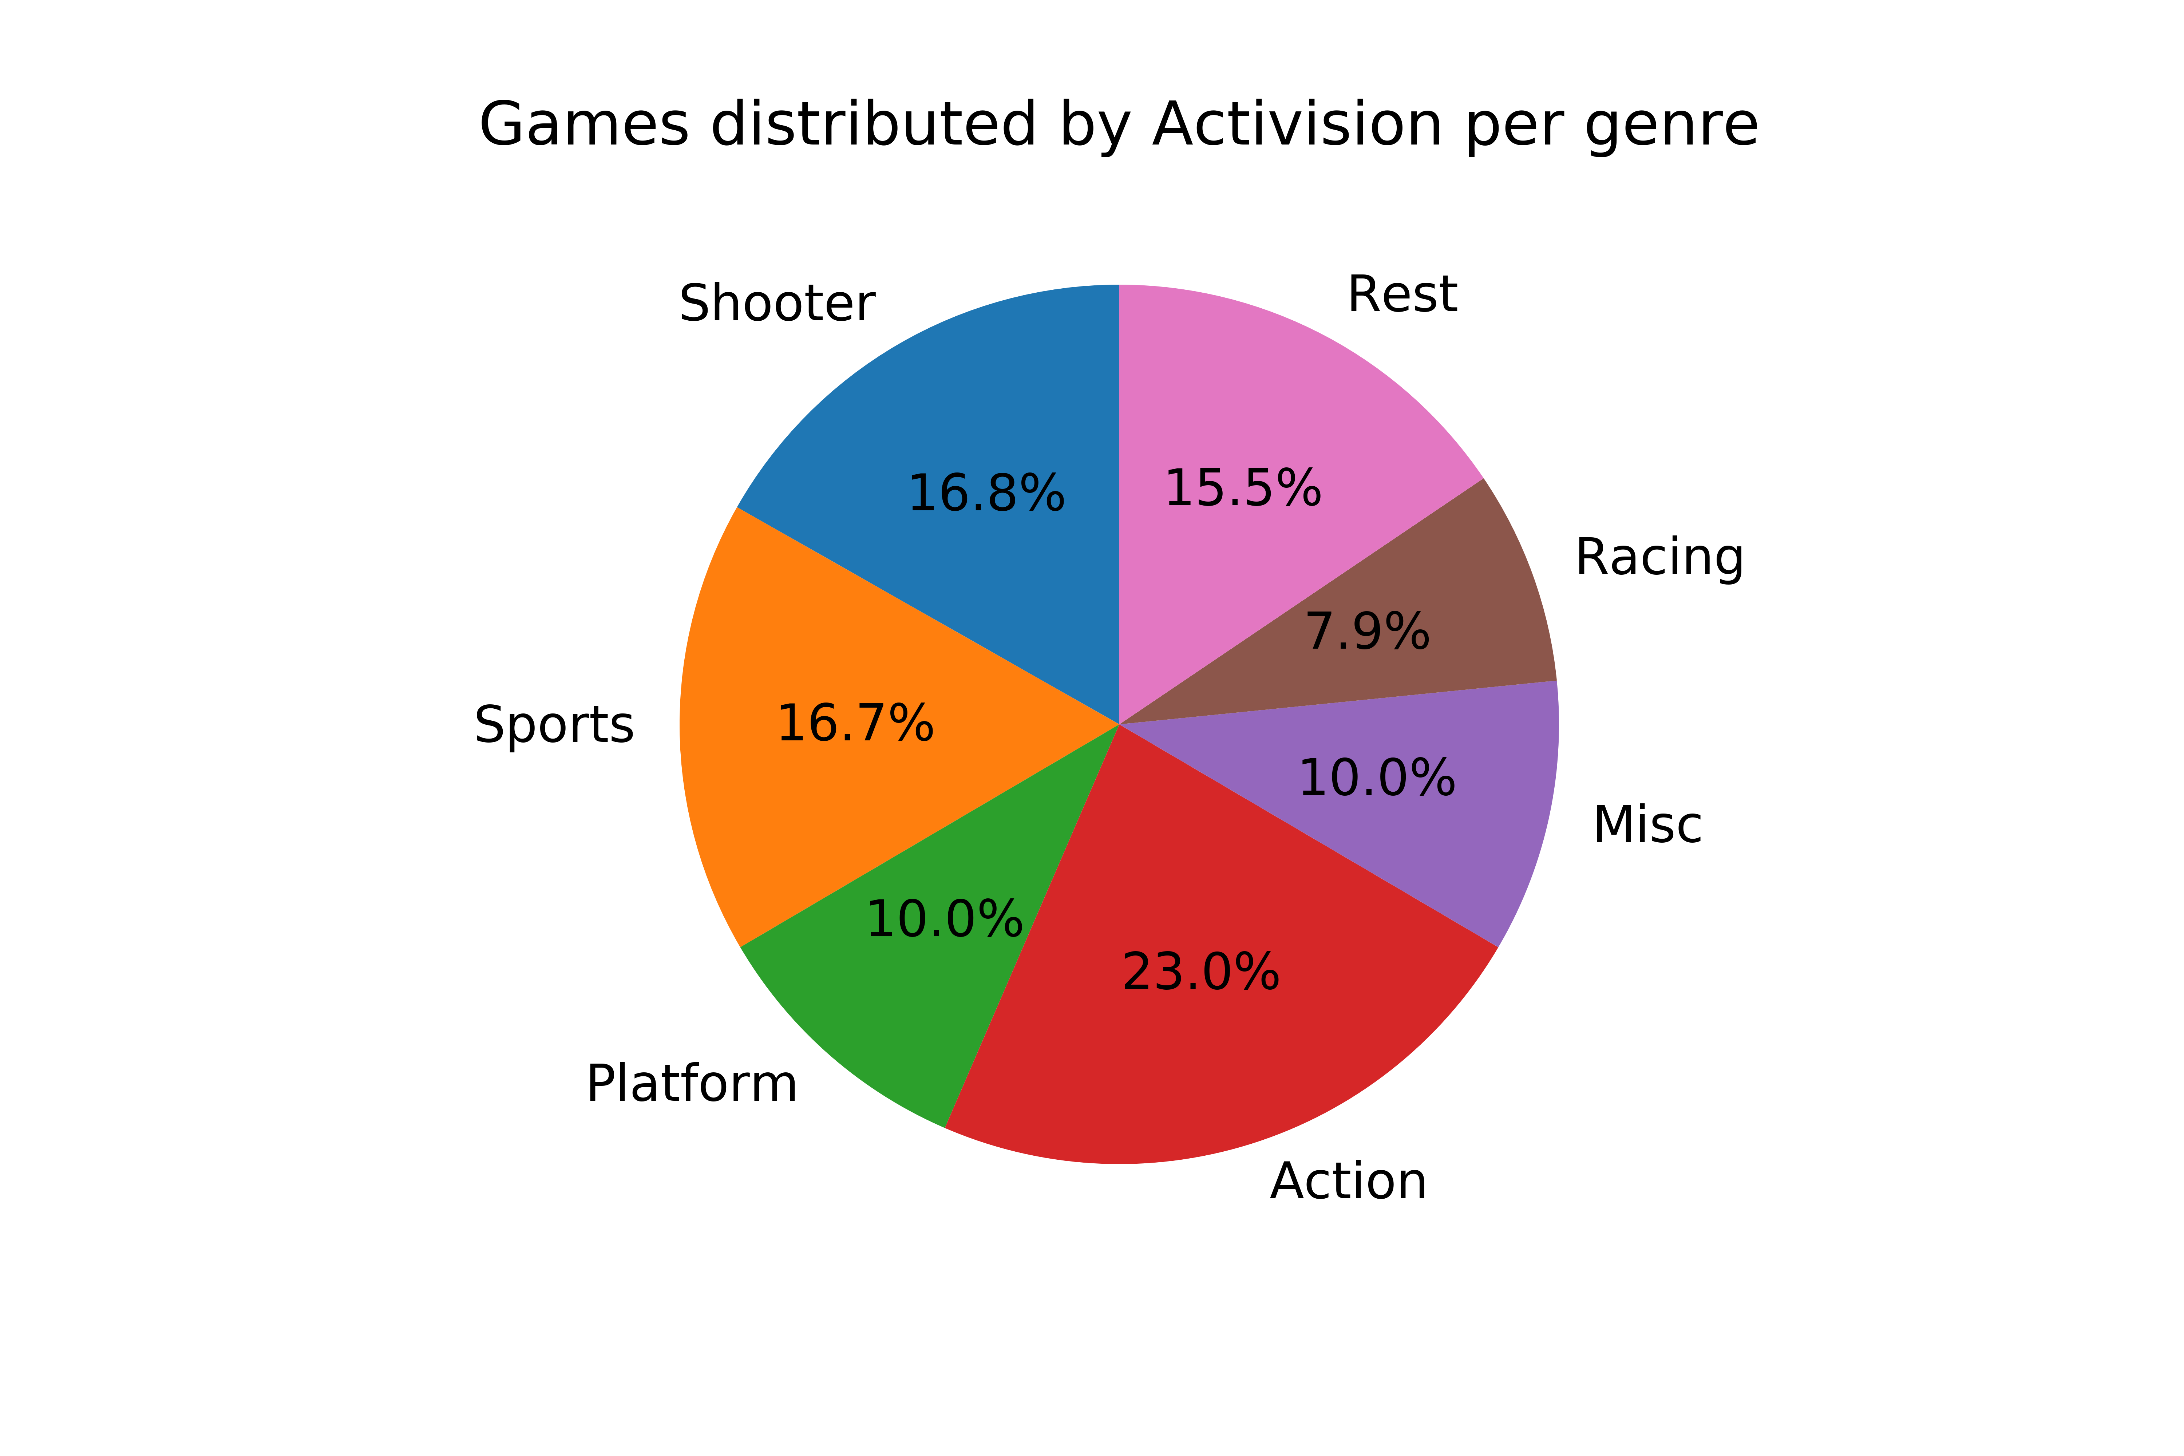
Publisher: Platforms and genre of Activision distributed games?
Platform: vast majority of games distributed by AV are from PS and XBox (also PC)
Genre: AV distributes a majority of games characterized as Action and Shooter
Big experience of Activision in distributing in NA and European markets!
Exclusivity agreement? No presence in Japanese market

Slide 24
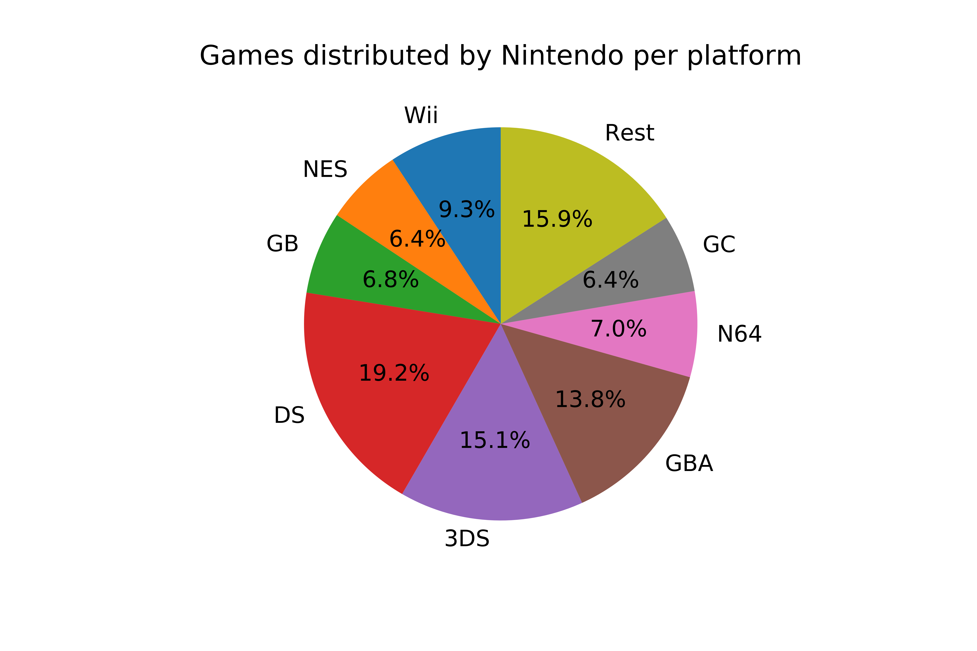
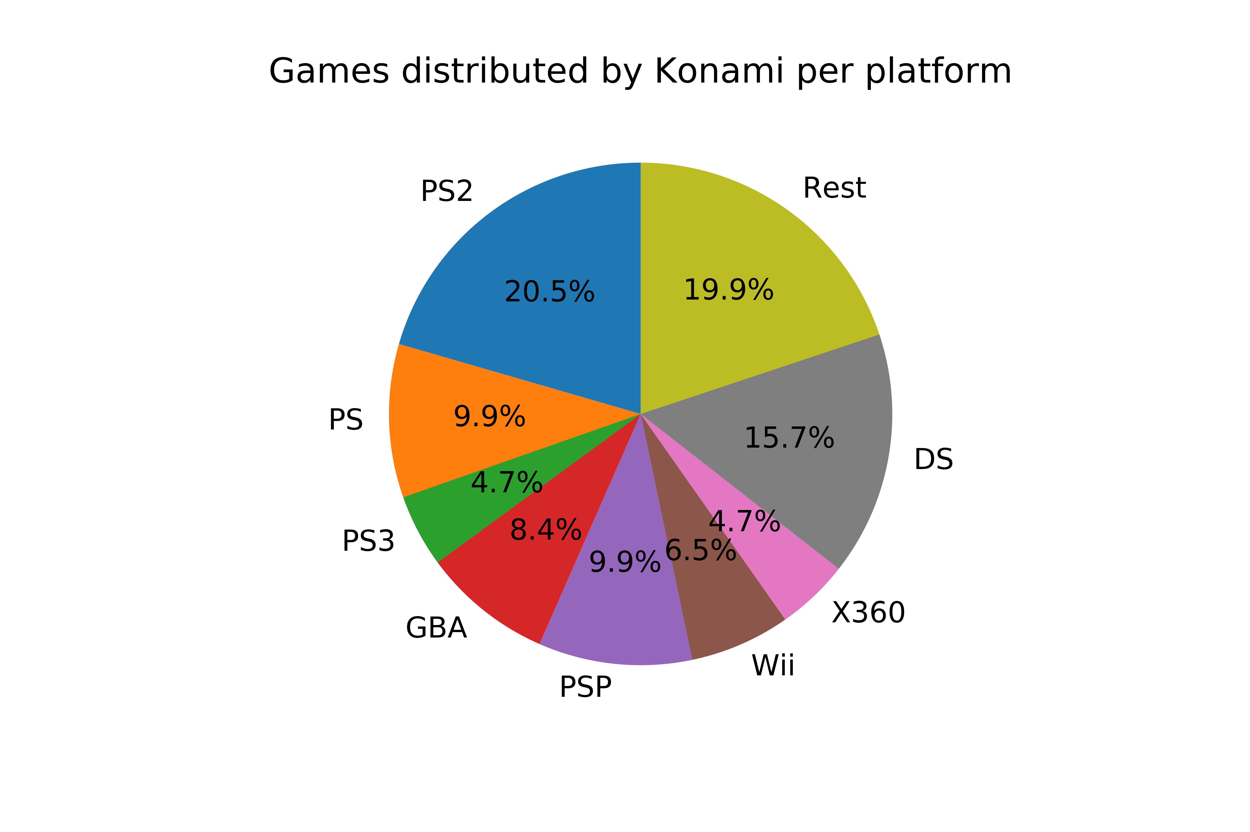
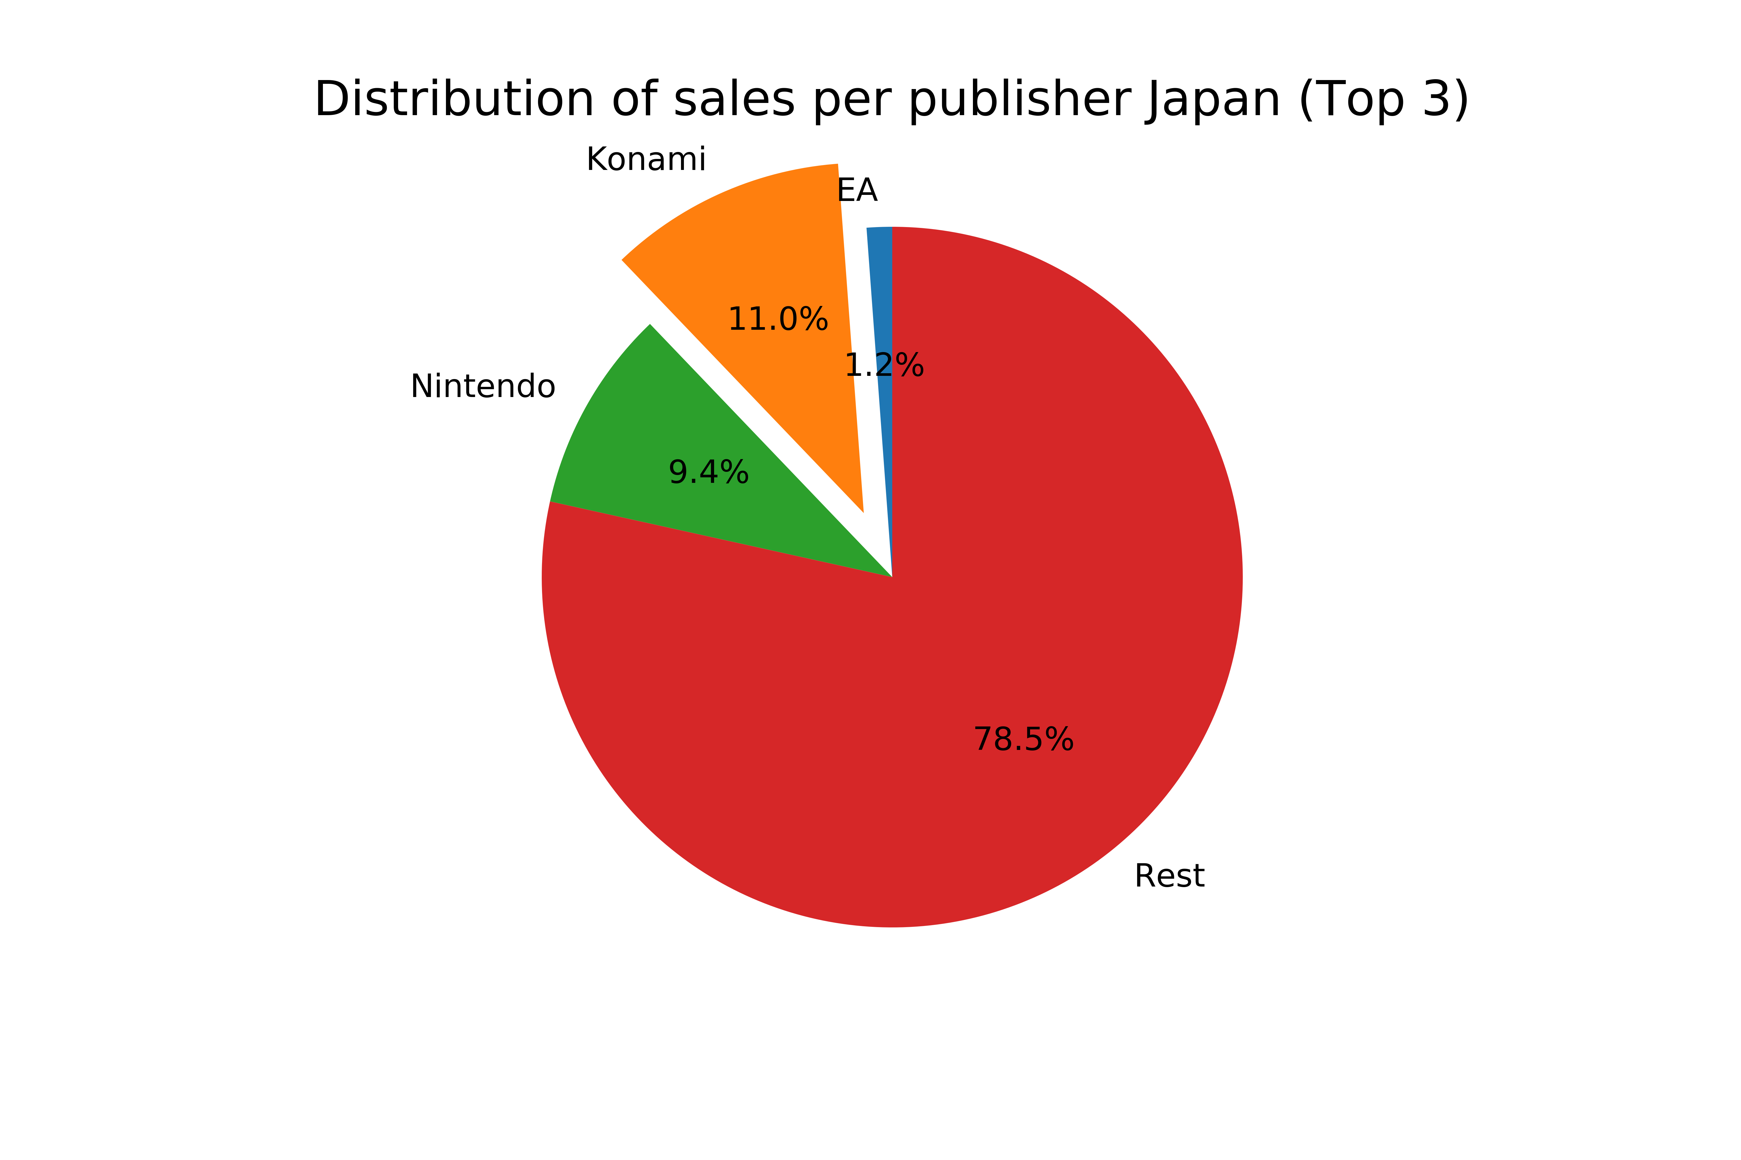
Publisher: Japanese market
2 main options: Konami and Nintendo
Nintendo generally distributes the games developed for their own consoles (not in our interest)
Konami: experience in distributing PS games especially, also XBox
Japanese market distributor: Konami

Slide 25
4. Conclusions

Slide 26
Defined Business Strategy
Game characteristics to maximize sales (long-term)
Platform: PS5 / XBox Series X / PC
Markets: European, North American, Japanese
Genre: Action
Theme of the game should preferably comprehend shooting in some way but should not be based on shooting exclusively
ESRB Rating: Teenager +13
Publisher: Activision (Europe / North America), Konami (Japan)

Slide 27
Real-life case scenario
Case Study Fortnite
C
Games: Fortnite, Fortnite: Save the World, Fortnite: Battle Royale
Year of release: 2017
Platforms: PS4 / XOne / PC (Windows, MacOs) / iOS / Android / NS
Genre: Action / Shooter (depending on version)
ESRB Rating: Teenager +13
Players: ~200 millions in November 2018
Revenue: total revenue for 2018 is estimated at 2.4 billion$ *
Notes:
* https://www.businessofapps.com/data/fortnite-statistics/

Slide 28
Thank you very much for your attention
Any questions?

